Slide 1
Resource Mobilization for the effective implementation of the regional E-waste management Strategy
Federico Magalini – Managing Director Sofies UK

Slide 2
EACO e-waste strategy
(adopted in Kampala, July 2017)
Impact
Zero negative impact of e-Waste in EACO member states by 2030
Budget allocated to individual outcomes (approx. 1,7M$)
Detailed breakdown of activities available
EACO Looking for PPP options
EACO strategy & local developments (policy) to be linked
Outcomes
Harmonized & aligned legal, policy and regulatory framework for e-waste in EACO member states
A rationalized, well distributed and developed e-waste management infrastructure
A comprehensive resource mobilization mechanism implemented
Strengthened capacity for coordination of e-waste management at EACO
An established Research, Monitoring & Enforcement System, Innovation as well as developed capacity for e-waste management in EACO member states
Outputs
  Regional e-waste policies, guidelines and standards developed for EACO member states.
  Regional e-waste policy, guideline and standard adopted at national level
  E-waste management infrastructure requirements mapping
  E-waste management infrastructure roll out plan development
Regional E-waste resource mobilization strategy developed and implemented
EACO e-waste fund is established to collect EPR fees, ARF individual, corporate and donor contributions
E-waste management is mainstreamed in educational curriculum at various levels especially in technical school
E-waste regional steering committee operations and functions supported for effective coordination of the implementation of the regional e-waste strategic plan

Slide 3


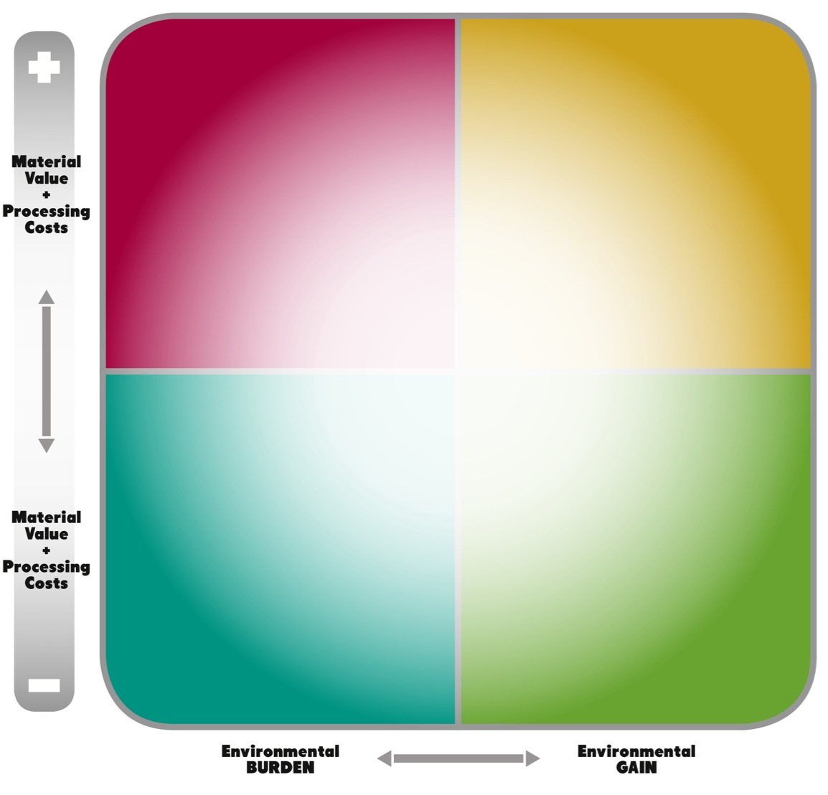

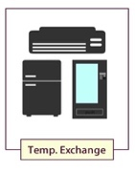
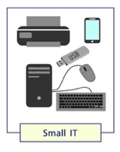





Why do WEEE need policies and financing?
For great majority of e-waste products, financial compensation is needed for proper treatment (let alone collection & access to waste)
Market dynamics alone cannot ensure sound-treatment of e-waste (cherry picking and rudimental recycling pose serious risks)
Not all the products are equal in terms of:
  Intrinsic economic value
  Hazardous content and risks at End-of-Life
Business Perspective
Environmental (societal) Perspective

Slide 4
Why do we need funding?
The strategy laid down an ambitious and coherent plan to address the current gaps in the region:
  Development, adoption and ENFORCEMENT of policies for e-waste management
  Mapping infrastructure (& development of plan to ensure their deployment)
  Ensure capacity is developed, locally
Funds are currently lacking and sources need to be identified, under two scenarios:
  Institutional donors / projects (Money to EACO)
  Alignment with ongoing projects / funding opportunities already committed by donors (Money supporting activities in the EACO strategy)

Slide 5
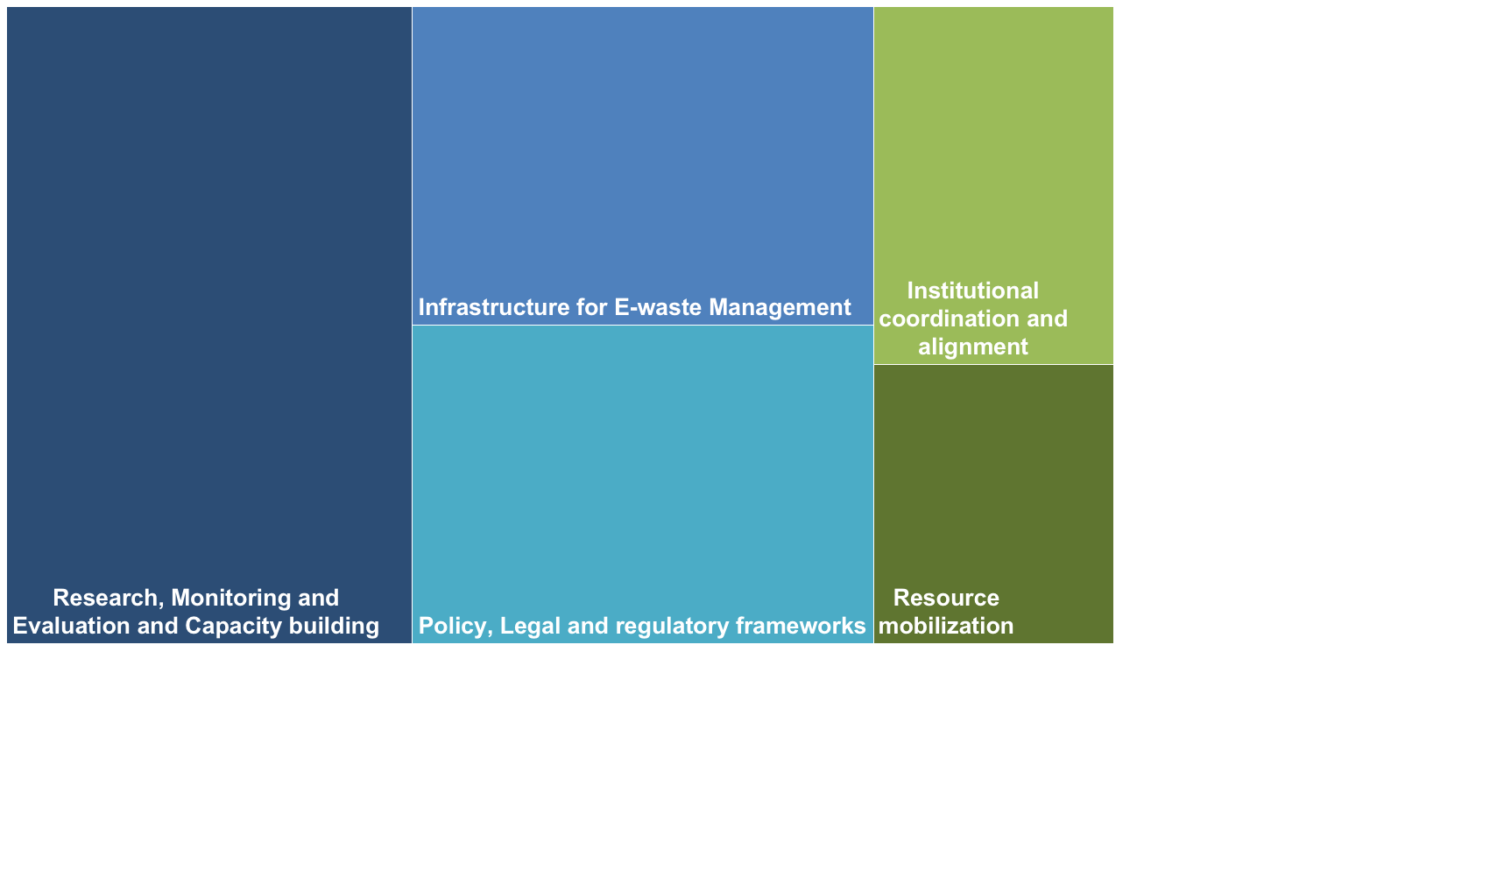
Budget allocation
350,000 $
205,000 $
615,000 $
350,000 $
160,000 $

Slide 6
Budget allocation & priorities
Priority 1
Priority 2
Priority 3
Priority 4
Priority 5

Slide 7
How can resources been mobilized
Currently the following agencies/organizations has been approached (shared EACO Strategy & Plan):
  UNEP, UNIDO, ITU, WHO, IFC, US AID, US EPA, DFID (UK), CDC (UK), GIZ (DE)
Institutional funding could be investigated (f.i. Europe Aid, Switch Africa,…), but projects need to be developed to be linked with general workplan
Proposal are always stronger when:
  National government are involved/supporting
  Co-financing from government or private sector are available (needed for some funding agencies like GEF, EU, etc..)

Slide 8
Background Sofies

Slide 9
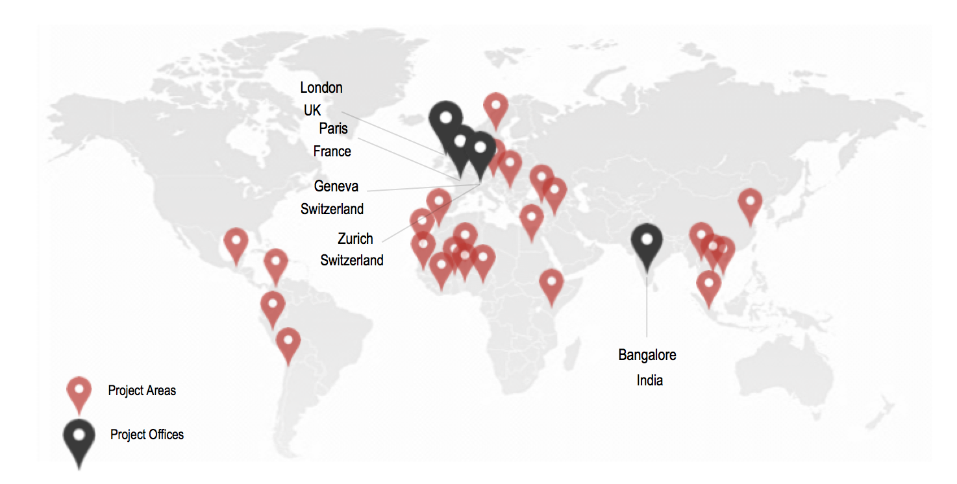
Who are we?
35
Employees
500+
Projects
100
External
technical and field experts
40
Countries
5
Offices:
Bangalore | Geneva | London
Paris | Zurich

Slide 10





Our Domains of Intervention
Smart territories
Making territories more sustainable through systemic and integrated approaches
Secondary resource and urban mining
Turning wastes into resources
Sustainable industrial zones
Making industrial areas more sustainable and attractive through industrial symbiosis
Alternative Energy Systems
Developing alternative to fossil fuels with climate positive and renewable energies
Sustainable production and processing
Ensuring competitive and long term business based on an optimal use of resources and energy
Managing Sustainability
Driving sustainability: Innovate, manage, monitor, asses and report

Slide 11
Q&A: federico.magalini@sofiesgroup.com
Thank you

