Slide 1
Global Policies and Regulations for E-waste management
Federico Magalini – Managing Director Sofies UK

Slide 2
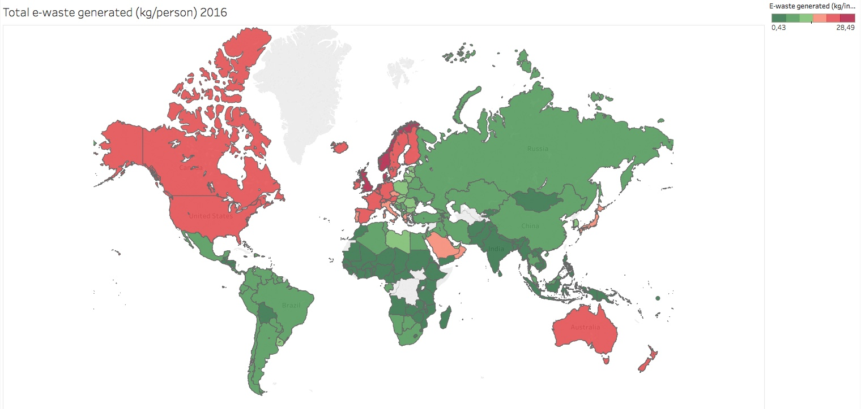
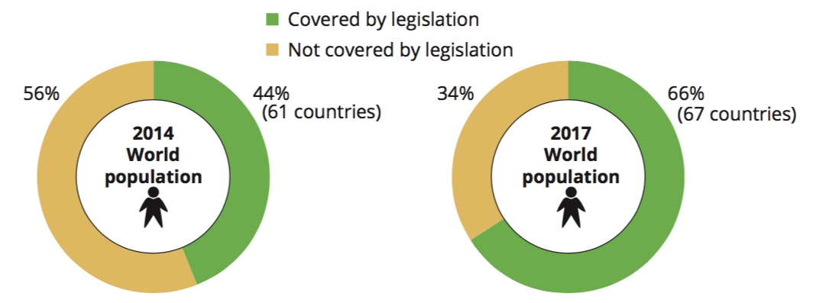
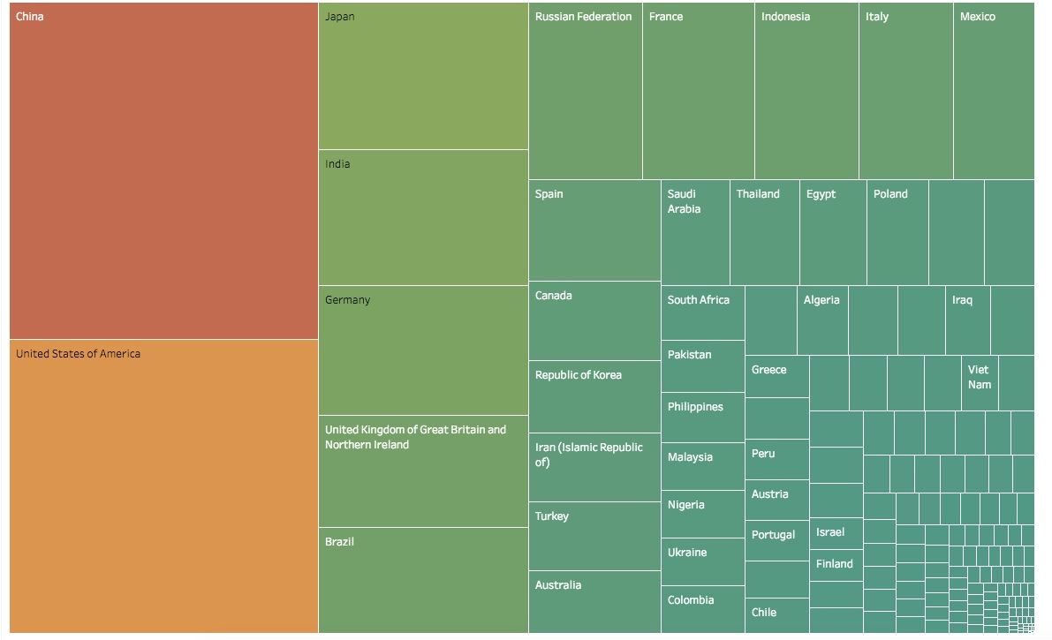
Global landscape for e-waste generated (2016 data)
Generation total amount
Source: UNU Global E-waste Monitor 2017 (2016 data)

Slide 3
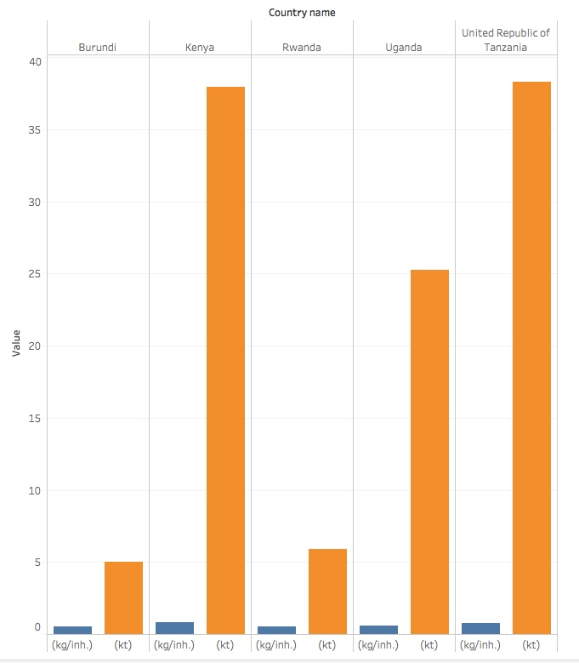
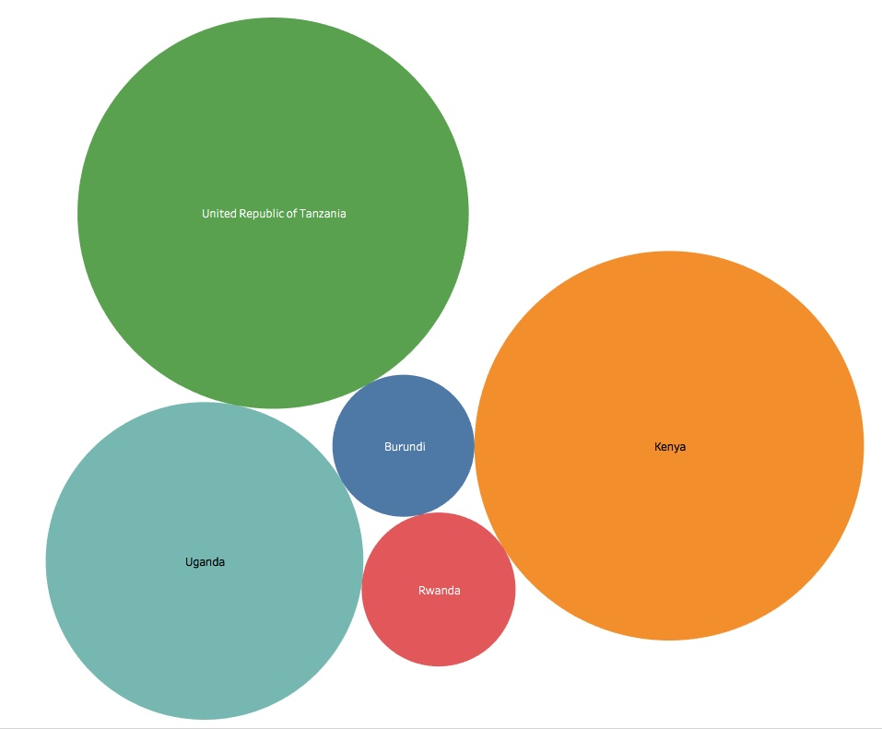
Overview East Africa
Source: UNU Global E-waste Monitor 2017 (2016 data)

Slide 4
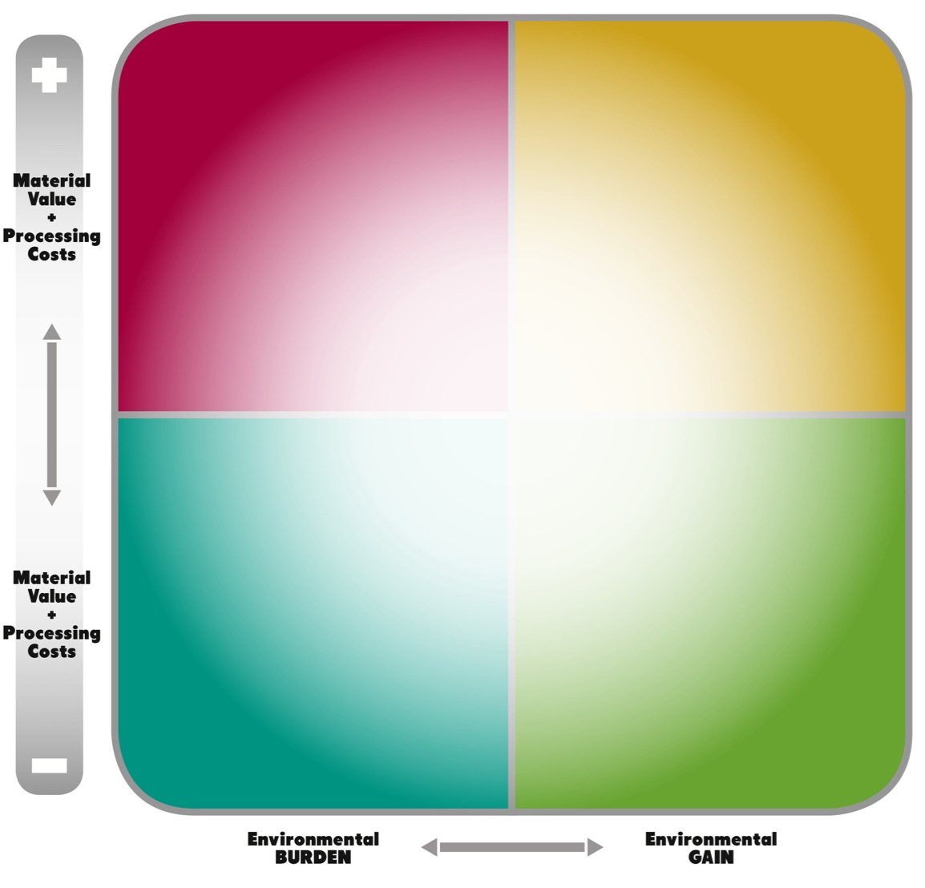
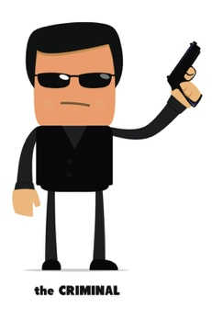



Where and why do we need standards, rules & policies?
“Setting” the rules
“Pushing” for BAT
Business Perspective
Environmental (societal) Perspective
“Shaping” operations

Slide 5
WHO is really paying for “waste” management
Three options existing:
    Tax-payers
    Consumers (or waste holders)
    Producers (EPR)
No matter “who” is paying cost-effectiveness is a paramount:
    Minimize taxes = Society happy (votes)
    Low costs = consumers happy (growing economy)
    EPR = increase price (☹) or decrease margins (risk for SMEs & markets)

Slide 6
EPR: Theory vs Practice
Producers = not only OEMs (but any player making profits out of selling new/used products)
    Local assembler,
    Local importer,
    Local producer/distributor
E-waste management is much more than Design for Recycling
    Efficient & effective collection
    Downstream markets
    Use of best suitable “technologies”
+ EOL (EPR)
OEM = Product Design + Manufacturing
SEPARATE
COLLECTION
TRANSPORT
RECYCLE
TREATMENT
REUSE
System Design
DISPOSAL

Slide 7
What does EPR means in practice?
Other EPR stretch
Each cost is linked to (originated by) activities performed by stakeholders
Framework Costs
Other Costs
Guarantees
Awareness Raising
Audit
Enforcement
Usual EPR domain
Technical Costs
Access to Waste
Containers
Transport
Treatment
In certain cases treatment might generate revenues
First 3 activities usually represent NET costs

Slide 8
Key questions to set-up EPR scheme
WHO is paying for WEEE Management? (political decision)
  Tax-payers (residual, as long as legislation is being deployed)
  Consumers (e.g. California, upon purchase product)
  Waste holders (e.g. Japan, or non-household streams in EU)
  Producers (Extended Producer Responsibility , 98% of policy bills…),
HOW MUCH? (technical + political)
TO WHOM? (political)
    State-controlled, monopolistic body (under ministry (f.i. California, Ghana), or ad-hoc created (f.i. Mauritius))
    Compliance Schemes, to be set-up by Producers (having the responsibility to comply)
TECHNICALITIES on how fees are collected (technical)
  When importing products
  Dedicated time-slots

Slide 9
Is there an unique way to implement EPR?
Difference financing models exist:
  EU WEEE Directive (EPR: Financial + Organizational)
  California (consumers pay upon purchase)
  Japan (consumers pay upon disposal)
  Ghana or China (EPR: Financial only)
No matter the model, money raised should be 100% transferred to finance technical and framework costs
A tailored solution can be developed for EACO & individual countries
How much time do WEEE need? 2 to 3 years if we have strong commitment

Slide 10
Background Sofies

Slide 11
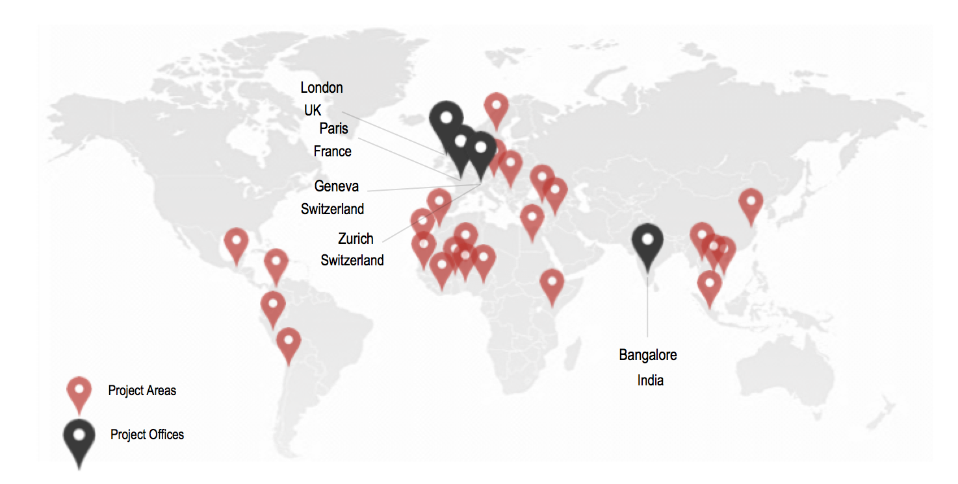
Who are we?
35
Employees
500+
Projects
100
External
technical and field experts
40
Countries
5
Offices:
Bangalore | Geneva | London
Paris | Zurich

Slide 12





Our Domains of Intervention
Smart territories
Making territories more sustainable through systemic and integrated approaches
Secondary resource and urban mining
Turning wastes into resources
Sustainable industrial zones
Making industrial areas more sustainable and attractive through industrial symbiosis
Alternative Energy Systems
Developing alternative to fossil fuels with climate positive and renewable energies
Sustainable production and processing
Ensuring competitive and long term business based on an optimal use of resources and energy
Managing Sustainability
Driving sustainability: Innovate, manage, monitor, asses and report

Slide 13
Q&A: federico.magalini@sofiesgroup.com
Thank you

