Slide 1
Technical Assistance for the implementation of Regional E-waste management Strategy
GIZ Expert Pool
Federico Magalini, Sofies
Mathias Schluep, WRFA
Notes:
Terms of use
This training material is property of GIZ. You may not alter this slide, add or delete any content nor change the master slides. The GIZ logo may not be removed or displaced nor may any other logo or information be placed in the header or footer area of the master slides. Before adding any information to this training mazerial, please contact climate@giz.de.

Slide 2



Published by
Deutsche Gesellschaft für
Internationale Zusammenarbeit (GIZ) GmbH
Registered offices, Bonn and Eschborn, Germany
„Advisory project Concepts for sustainable solid waste management“
T +49 61 96 79-1289
F +49 61 96 79-801289
E Ellen.Gunsilius@giz.de
I www.giz.de
Responsible
Ellen Gunsilius
Author(s)
Photo credits
© GIZ/…..
In cooperation with
Notes:
Terms of use
This training material is property of GIZ. You may not alter this slide, add or delete any content nor change the master slides. The GIZ logo may not be removed or displaced nor may any other logo or information be placed in the header or footer area of the master slides. Before adding any information to this training mazerial, please contact climate@giz.de.

Slide 3
Background of GIZ Expert pool project
A pool of international experts (lead by Oeko-Institute) has been contracted to support GIZ e-waste program
  Oeko, Sofies, UNU and WRFA involved in the team
The pool of international experts will work with selected national consultants
The project will run till February 2019 and focus on different topics (WPs) and geographical areas
  WP1: focus on EACO e-waste strategy (lead Sofies)
  WP2: focus on off-grid lead acid batteries, geographical focus not yet defined (lead Oeko)
  WP3: focus on concepts to be brought into political processes, e.g. on financing for e-waste management (lead UNU)

Slide 4
EACO e-waste strategy & GIZ Expert Pool support
1) Review existing Policy, laws, standards, guidelines & identify gaps
2) Support development regional e-waste policy, guidelines and standards
3) Support alignments of national policies, guidelines and standards
4) Conduct E-waste management infrastructure requirements analysis

Slide 5
Background policy & infrastructure
Country | E-waste legislation | Availability recycling infrastructure
BUR | First Draft | Fair / to be improved (?)
KEN | Draft, pending final approval | Fair / Good (?)
TAN | No Draft | Fair / to be improved (?)
RWA | Published framework legislation | Fair / Good (?)
UGA | No Draft | Fair / to be improved (?)
Recycling Infrastructure (excl. collection)
Fair means:
  One/few e-waste recyclers available, decent operations (mainly manual disassembly) with no “red flags”
  Handling of lead-acid batteries fraction still a challenge in majority of countries
Good means:
  Some dedicated technologies for de-pollution or treatment available (CRT cutter, Degassing for CFC, cable strippers,…)

Slide 6


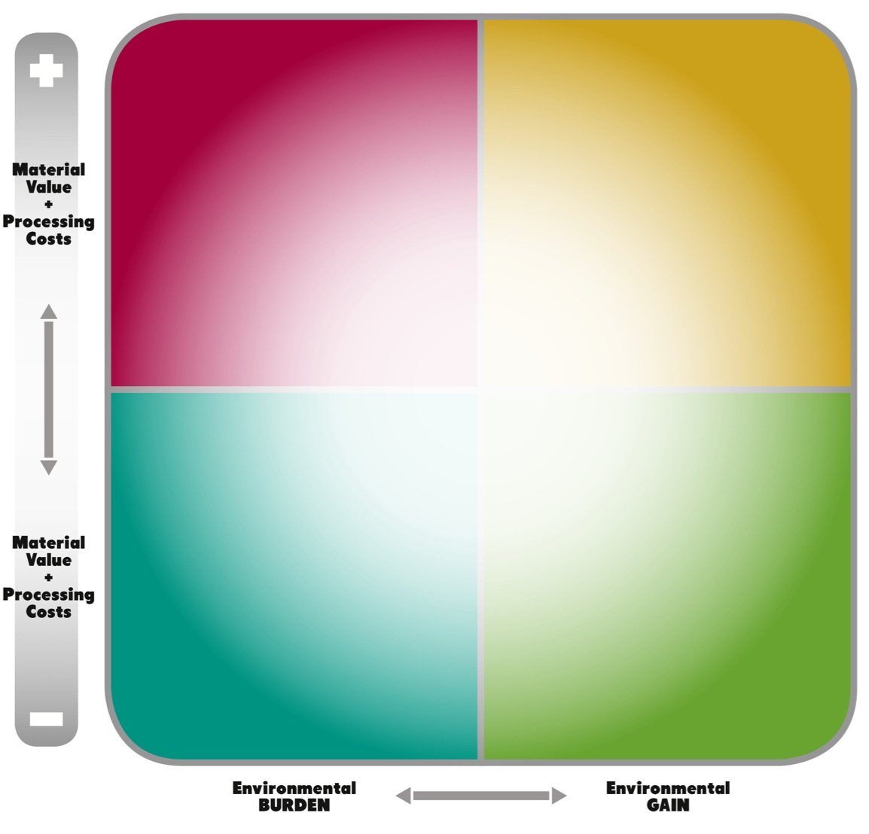

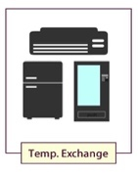
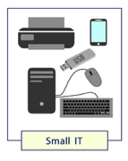





Why do WEEE need policy & Infrastructures
For great majority of e-waste products, financial compensation is needed for proper treatment (let alone collection & access to waste)
Market dynamics alone cannot ensure sound-treatment of e-waste
Not all the products are equal in terms of:
  Intrinsic economic value
  Hazardous content and risks at End-of-Life
Tailored solutions need to be developed (impact on financing)
Business Perspective
Off-Grid Solar
Environmental (societal) Perspective

Slide 7
Workplan proposed
Task | 1) Review existing policies / guidelines / standards | 2) Support development of policies / guidelines / standards | 3) Support national alignment | 4) Infrastructure mapping
Geographical focus | National level | EACO level | National level | National level
Timing | 05/18 – 08/18 | 07/18 – 09/18 | 09/18 – 02/19 | 05/18 – 10/18
Main activities | Collect all existing draft/published bills/guidelines/strategic documents Analyse with consistent framework Gap analysis | Develop roadmap for harmonization of policy requirements | Support at national level implementation of guidelines/standard/policies | Develop framework for mapping collection & recycling infrastructures (pre-processing & outlet for main fractions) Mapping at country level
Roles of stakeholders | Providing data Reviewing results | Reviewing results | Implementation on the ground | Providing data
Main players | National e-waste committee members National governments | Regional e-waste committee members EACO | National governments | National e-waste committee members

Slide 8
Task 1: Review existing policies/guidelines/standards
 | Examples of Policies/guidelines/Standards applicable/related to EEE/E-waste Management | Key elements to be investigated
BUR | Environmental Law N° 1/01/010, 2000 Law-Decree N° 1/16 on Public Health Law-Decree N° 1/37 on Labour code | Do we have other relevant policies/guidelines/standards? What’s their status? Who is responsible for adoption? Enforcement? Which are the main stakeholders involved?
KEN | E-waste Management Law (Machakos County only) 2015 Environmental Management and Co-Ordination (E-Waste Management) Draft Regulations, 2013
TAN | Environmental management Act N 20 (2004) Environmental Management (Hazardous Waste Control) regulations 2009 Guidelines for Management of Hazardous Waste 2013
RWA | National sanitation policy National E-waste Policy Environmental law ( article 16 – E-waste management ) E-waste Regulations
UGA | Electronic Waste Management Policy, August 2012 National Electronic Waste Management Strategy, December 2013 Finance Bill No. 10

Slide 9
Task 2: Support development policies/guidelines/standards
What is needed to have EACO adopting a common/consistent framework?
Role of individual governments vs central role (e.g. EU Directive vs 27 National transpositions)
Currently different countries have different “models” in the legislation proposed (e.g. financing mechanism), even if based on EPR (except Tanzania)
How can we envisage the adoption of a consistent framework to ensure “common market” without distortion?
What do we need to achieve EACO strategic goals on policy?

Slide 10
Task 3: Support national alignment
Common framework/model is the starting point. But policies need to be adopted at NATIONAL level:
Can we have policies in place in all countries by 2019?
What is hampering the adoption of current draft (e.g. Kenya)? How can we facilitate the removal of stumbling blocks?

Slide 11
Task 4: Infrastructure mapping
Mapping will be done according to the:
  Main steps in the recycling chain (collection and pre-processing)
  Availability of national/regional outlets for main fractions (critical ones) of various e-waste streams
  Will include acceptance criteria and capacity where possible (t/year).

Slide 12
How to engage the project team
Contact focal points
  International
  National consultants: to be soon announced
Provide input/data/suggestions/recommendations.
Timing is crucial so do not be shy or wait last minute: the sooner the better!

Slide 13
Thank you for your attention!
Federico Magalini, Sofies
E: federico.magalini@sofiesgroup.com
Mathias Schluep, WRFA
E: mathias.schluep@wrforum.org
Ellen Gunsilius
Senior Advisor - Concepts for sustainable SWM
Division Climate Change, Environment & Infrastructure
Deutsche Gesellschaft für Internationale Zusammenarbeit (GIZ) GmbH
65726 Eschborn
E Ellen.Gunsilius@giz.de
I http://www.giz.de/solid-waste-management
Notes:
Terms of use
This training material is property of GIZ. You may not alter this slide, add or delete any content nor change the master slides. The GIZ logo may not be removed or displaced nor may any other logo or information be placed in the header or footer area of the master slides. Before adding any information to this training mazerial, please contact climate@giz.de.

