Slide 1

E-waste Statistics: Regional and Global Perspectives
Dr John WASSWA
Makerere University

Slide 2
Scope
Stool pigeon
  The Global E-waste Monitor 2017
  Country E-waste Status and Trends (Obsolete)
  Research Publications
Standards and Methodologies to Measure E-waste
Challenges

Slide 3
Global e-waste generated
Annual growth rate of 3 to 4%.

Slide 4
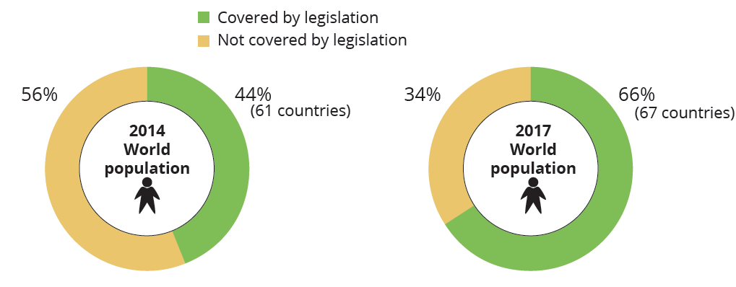
By January 2017, appro 4.8 billion people were covered by national legislation, which is 66% of the world population.

Slide 5
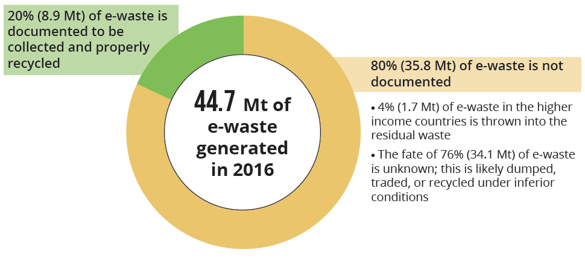
Collection methods of e-waste in 2016

Slide 6
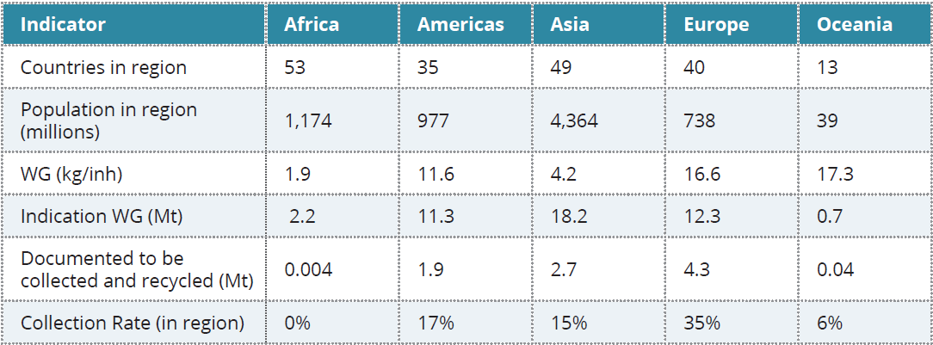
E-waste generation and collection per continent

Slide 7
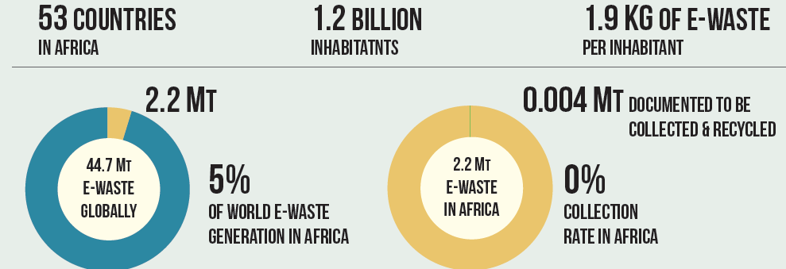
E-waste in Africa
Domestic e-waste generation was approx 2.2 Mt, with contributions from Egypt (0.5 Mt), South Africa and Algeria (each 0.3 Mt) ranking highest.

Slide 8
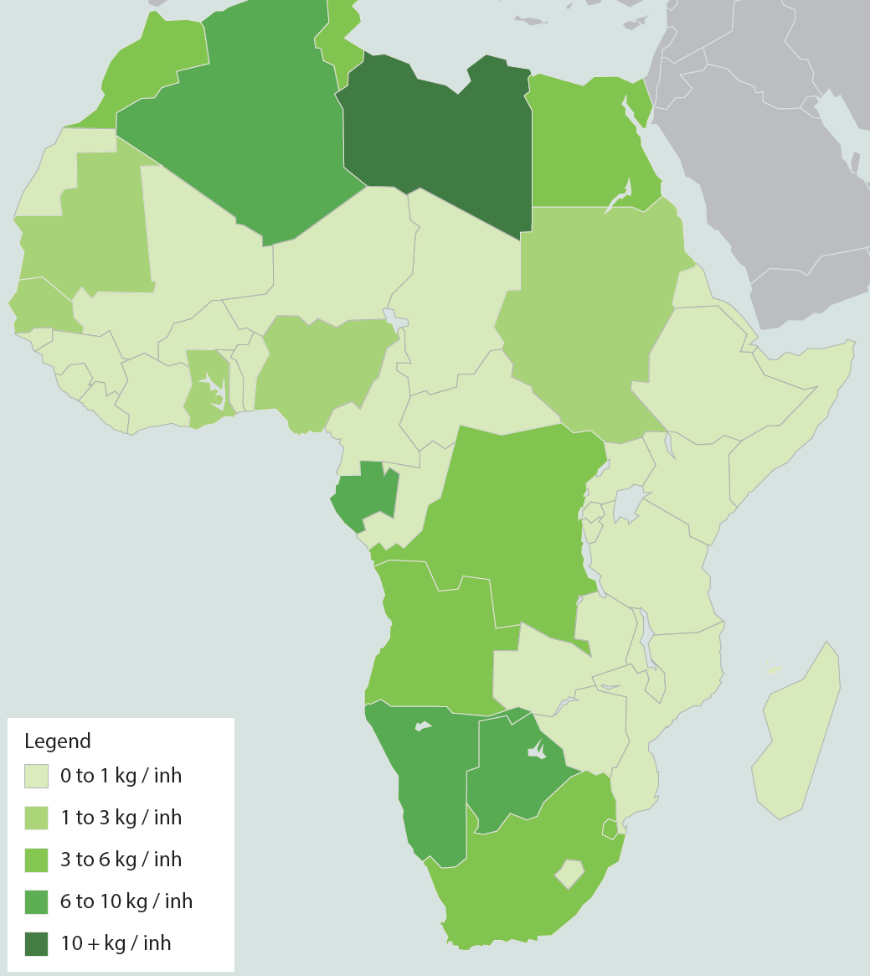
Little information is available on the amount of e-waste documented that is collected and recycled by the formal sector in Africa

Slide 9
E-Waste in E- African Region
Need on update of statistics
  Kenya –
  Uganda
  Tanzania
  Rwanda
  Burundi
  South Sudan

Slide 10
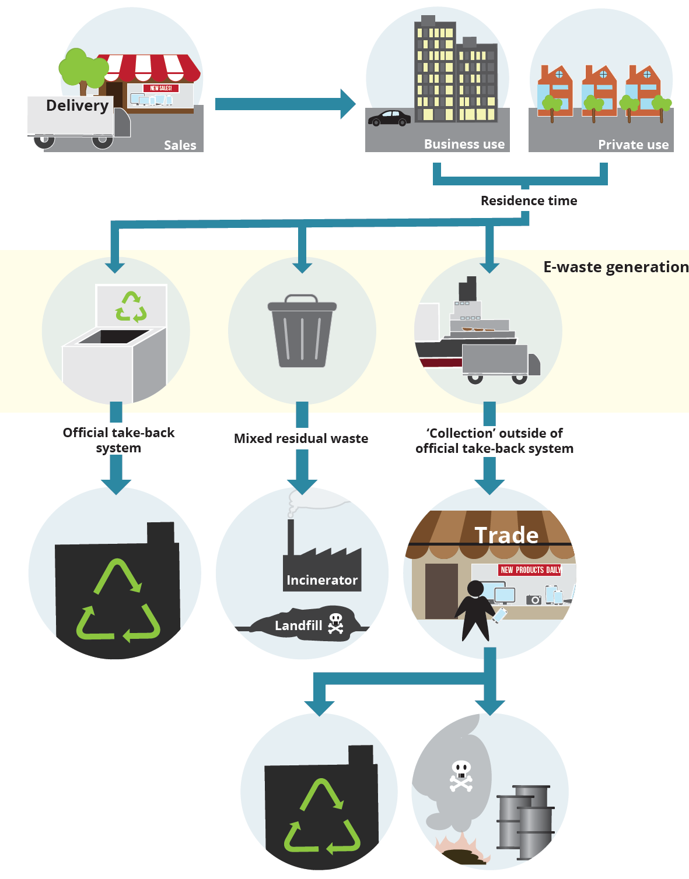
Standards and Methodologies to Measure E-waste

Slide 11
Indicators
Indicator 1: Total EEE Put on the Market
Indicator 2: Total E-waste Generated
Indicator 3: E-waste Officially Collected and Recycled
Indicator 4: E-waste Collection Rate

Slide 12
Classifications for E-waste
Temperature exchange equipment.
Screens, monitors.
Lamps
Large equipment.
Small equipment.
Small IT and telecommunication equipment.

Slide 13
Measuring Framework of E-waste Statistics
Phase 1: Market Entry
  Data can come from statistics on sales from a national e-waste registry for compliance with the Extended Producer Responsibility, or if not available, it can be measured with the ‘apparent consumption method

Slide 14
Phase 2: Stock
The stock of EEE can be determined using household or business surveys on a national level.
If that data is not available, it can be calculated using the sales information and the time the equipment spends in the stock phase, called the “product’s residence time”.

Slide 15
Phase 3: E-waste Generated
When the product becomes obsolete to its final owner, is disposed of, and turns to waste, referred to as “e-waste generated”.
It is the annual supply of domestically generated e-waste prior to collection, without imports of externally generated EEE waste.
The outcomes of e-waste generated are an important indicator for e-waste statistics.

Slide 16
Phase 4: E-waste Management
E-waste Collection Scenario 1: The Official Take-Back System
  Under the requirement of national e-waste legislation, e-waste is collected by designated organizations, producers, and/or the government.

Slide 17
E-waste Collection Scenario 2: Mixed Residual Waste
In this scenario, consumers directly dispose of e-waste through normal dustbins with other types of household waste.
As a consequence, the disposed of e-waste is then treated with the regular mixed-waste from households.

Slide 18
Scenarios 3+4: The Collection Outside the Official Take-Back System
Countries with Developed Waste Management
  Possible destinations for e-waste in this scenario include metal recycling, plastic recycling, specialized e-waste recycling, and also exportation.
Countries With No Developed Waste Management Infrastructure

Slide 19
Countries With No Developed Waste Management Infrastructure
    In most developing countries, there is an enormous number of self-employed people who are engaged in the collection and recycling of e-waste.
    They usually work door-to-door to buy e-waste from consumers at home, and then sell it to be refurbished and recycled.

Slide 20
The Challenges
Lack of data especially from customs and distributors
The informal sector
Branded Vs counterfeit

Slide 21
Thank you very much for your kind attention

