Slide 1

EACO REGIONAL E-WASTE MANAGEMENT STRATEGY
Presented by: Olivier MBERA
Chairperson RSC/ CGM Enviroserve Rwanda
3rd EACO Regional Awareness Workshop
Kigali , Rwanda

Slide 2
Towards Zero Negative Impact of e-waste in EACO member States by 2030
Agenda
1. Regional Strategy Development Steps
2. Understand the Challenge
3. Review Regional and Global Best Practices
4. Outline Solutions
5. Articulate Implementation Framework

Slide 3






Strategy development steps
Strategic Operating Plan Process
Step 1 – Perform Situation Analysis
Step 2 – Stakeholder Consultations
Step 3 – Review Regional Best Practices
Step 4 – Identify Strategic Priorities
Step 5 – Define Strategic Plan
Step 6 – Develop M&E Framework
Step 7 – Implementation plan
Strategy
Operations
People

Slide 4
“ Towards Zero negative impact of e-Waste in EACO member states by 2030”
Understand the Challenge
STRENGTH | WEAKNESS
Model regional e-waste management policy framework in place Political commitment by leaders in the member states e.g. ratification and adoption of relevant policies, laws and conventions Existence of E-waste management coordination structures at regional and national levels (EACO WG 10, National steering committee, Regional steering committees) Improved appreciation on awareness on matters of e-waste across the board (political, technical and general public) Implementation of e-waste management initiative EACO e.g. studies/ statistics Existing of some basic e-waste management infrastructure in some countries such as dismantling facilities in Kenya and Rwanda Existence of enabling environment at national level such as e-waste management policy and strategy in Uganda and draft policy in Rwanda, draft regulations and guidelines in Kenya. | Lack of adequate statistics on e-waste generation in the region Limited coordination of e-waste activities at regional level Lack of comprehensive awareness on e-waste especially among end-users, decision makers. Limited expertise in e-waste management within the region Inadequate e-waste management infrastructure and facilities. Insufficient e-waste policies laws and regulations and weak enforcement of existing ones and lack of harmonization of the existing ones Unpredictable flow of resources on e-waste management Lack of easy movement of e-waste in the region ( Transboundry movement procedures complicated)

Slide 5
Understand the Opportunities and Treats
OPPORTUNITIES | TREATS
Political Global push on e-waste management issues and initiatives by ITU, UN activities through UNFCCC, UNEP, Basel and Bamako Convention, StEP Regional integration and the EAC policy harmonization framework Global conventions, protocols, declarations. | Political Political instability in the region Set back on political will
Economic Economic opportunities arising from E-waste management Business and employment Potential for export growth | Economic Affluent societies – High consumption… Counterfeit of substandard goods
Social Growing activism on environment and Green computing Increased Awareness of negative impact of e-waste – Public health Potential positive on special impact groups such as women, youth and PWDs – people with disabilities. | Social Booming informal sector in the region Social practices and culture in handling e-waste (holding on items due to emotional attachment)
Technology Availability of available technologies Best practices for Bench mark | Technology Changing of technology making the ICT equipment’s inseparable Rudimentary technology like incineration or burning.
Environment Urban mining Reduced Greenhouse gases emissions | Environment Continued Poor disposal methods hence pollution to the environment Non segregation of waste
Legal | Legal

Slide 6



Opportunity of proper e-waste management in EACO member states
Social gain: formalised recycling creates
  large number of green jobs at all skill levels
  better social status as entrepreneurs & employees rather than subsistence actors
  better health and lower occupational hazards through proper use of tools and technologies
  higher and more regular incomes for workers who have more job security
Environmental gain: air, water and soil pollution avoided results in
  secondary raw material gained (such as gold, copper, steel, aluminium) otherwise lost in landfills or inefficient processes
  avoided remediation costs of contaminated sites
  feedstock to other industries eg. steel, aluminium, plastic and encourages green industrial development
Economic gain: developed industrial recycling resulting in
  improves government finances through higher taxes and lower costs for municipal bodies for waste disposal
  attracts investment and technology

Slide 7
Cost of improper e-waste management in EACO member states
Social cost: informal recycling as a subsistence activity creates
  direct social cost of low income from low quality fractions due to inefficient, sub-standard and hazardous processes
  indirect social cost of poor health, intermittent income, smoke, smell
Environmental cost: air, water and soil pollution from
  emissions that degrade soil, water and air resulting in contamination in the food chain
  Inefficient recycling processes result in unrecoverable material losses and need for more primary resources
  Economic cost: under developed industrial recycling resulting in
  lost intrinsic value of e-waste by the formal, and thus a net loss in tax revenues for the government
  low investment in installing recycling infrastructure

Slide 8
Vision and Goal of the EACO Regional E-waste Strategy
Vision
“ Towards Zero negative impact of e-Waste in EACO member states by 2030”.
Goal
Achieve a sustainable e-waste management system in the EACO member states”.

Slide 9
Outline Solutions
Strategic Objectives
Strengthen the policy, legal and regulatory framework for sustainable resourcing of e-waste management activities for effective protection of human health and environment within the region;
Put in place the requisite e-waste management infrastructure and rationalize its distribution across EACO member states to harness unique value and enhance synergy;
Establish mechanisms for comprehensive and sustainable mobilization for e-waste management resources (physical, financial and human resources);
Strengthen EACO e-waste coordination structures at regional and national levels
Promote research and innovation in e-waste management;
Put in place a monitoring and evaluation mechanism for e-waste management; and
Build capacity and create awareness for effective e-waste management in EACO member states

Slide 10
Outline Solutions
Five Strategic Pillars
Policy, Legal and regulatory frameworks
Requisite Infrastructure for E-waste Management
Resource mobilization
Institutional coordination and alignment
Research, Monitoring and Evaluation and Capacity building
EACO Regional Strategy has identified specific Interventions to address five strategic pillars

Slide 11
Proposed Interventions
Strategic Pillar 1 : Policy, Legal and regulatory frameworks
Outcome
Harmonized /Aligned legal, policy and regulatory framework for e-waste in EACO member states
  Transformative Intervention (To harmonize/ Align policy legal and regulatory framework for e-waste management in the EACO member states )
  Review existing Policy, laws, standards and guidelines for e-waste management in EACO member states to identify gaps
  Develop Regional e-waste policy, guidelines, laws, regulations and standards to act as model guiding national strategies
  Advocate for alignments of national policies, guidelines and standards to developed regional policies, standards and guidelines
  Facilitate the adoption and entrenchment of regional e-waste policy, guidelines and standards.
  Disseminate regional e-waste management policy, guidelines and standards to cater for the uniqueness of e-waste in EACO member states
Estimated Budget
  $ 100,000
  $ 50,000
  $ 100,000
  $ 60,000
  $40,000

Slide 12
Proposed Interventions
Strategic Pillar 2 : Infrastructure for E-waste Management
Outcome
A rationalized , well distributed and developed e-waste management infrastructure
  Transformative Intervention (To ensure rationalization of e-waste management infrastructure in the EACO member states)
  Conduct baseline survey on E-waste generation and volumes and develop an updated inventory to inform priority e-waste management infrastructure in the EACO member states
  Conduct an E-waste management infrastructure requirements analysis for the EACO member states
  Facilitate the development of a regional modern dismantling and recovery facility within the EACO member states
  Develop an e-waste management infrastructure roll out plan
  Put in place appropriate mechanisms for collection, transportation and disposal of e-waste such as the take-back systems with incentives for consumers, door-to-door collection etc
Estimated Budget
  $ 50,000
  $ 50,000
  $ 50,000
  $ 100,000
  $100,000

Slide 13
Proposed Interventions
Strategic Pillar 3 : Resource mobilization
Outcome
A comprehensive resource mobilization mechanism implemented
  Transformative Intervention ( Put in place a comprehensive Resource Mobilization mechanism for e-waste management)
  Develop a Resource Mobilization Strategy for effective implementation of EACO e-Waste Management Strategic Plan
  Streamline funding mechanisms for e-waste management
  Engage EEE producers/retailers in strategic partnerships including financing the e-waste collection, transportation and treatment through the extended producer responsibility and advanced recycling fee.
  Set up an EACO e-waste fund which will collect EPR fees, ARF individual and corporate contributions etc
  Conduct a feasibility study for the establishment of EACO e-waste fund.
Estimated Budget
  $ 20,000
  $ 20,000
  $ 25,000
  $ 40,000
  $ 50,000

Slide 14
Proposed Interventions
Strategic Pillar 4 : Institutional coordination and alignment
Outcome
Strengthened capacity for coordination of e-waste management at EACO
  Transformative Intervention (Strengthen EACO e-waste coordination structures at regional and national levels )
  Support the operations and functions of the Regional Steering Committee for effective coordination of the implementation of Regional e-Waste Strategic plan
  Establish collaborative frameworks with key regulatory bodies and other relevant stakeholders for the proper management of e-waste in EACO member states.
  Support the establishment of a Regional Producer Association as a mechanism for the implementation of EPR (Extended Producer responsibility), ARF (Advanced recycling fee), to enhance producer participation in e-waste management
  Establish proper mechanisms for sharing experience and knowledge on E-waste management
  Develop a communication and stakeholder engagement strategy on e-waste management
Estimated Budget
  $ 100,000
  $ 25,000
  $ 50,000
  $ 20,000
  $10,000

Slide 15
Proposed Interventions
Strategic Pillar 5 : Research, Monitoring and Evaluation and Capacity building ( Cont…..)
Outcome
An established research, M&E system, innovation as well as developed capacity for e-waste management in EACO member states
  Transformative Intervention (Promote research and innovation in e-waste management)
  Conduct studies and baseline surveys on E-waste
  Organize annual e-waste management innovation contests/ awards
  Mainstream e-waste issues in educational curriculum at various levels especially in technical school
  Collaborate with research institution to promote research and innovation on e-waste management
Estimated Budget
  $ 20,000
  $ 50,000
  $ 30,000
  $ 15,000

Slide 16
Proposed Interventions
Strategic Pillar 5 : Research, Monitoring and Evaluation and Capacity building
Outcome
An established research, M&E system, innovation as well as developed capacity for e-waste management in EACO member states
  Transformative Intervention (Put in place a monitoring and evaluation mechanism for e-waste management)
  Collaborate with stakeholders to establish and maintain a data base for e-waste generations/ volumes
Develop and implement a participatory monitoring and evaluation framework
  Support monitoring and evaluation for national e-waste management initiatives in member states
  Conduct midterm review and final evaluation of the regional e-waste management strategy
Estimated Budget
  $ 20,000
  $ 50,000
  $ 40,000
  $ 50,000

Slide 17
Proposed Interventions
Strategic Pillar 5 : Research, Monitoring and Evaluation and Capacity building ( Cont……)
Outcome
An established research, M&E system, innovation as well as developed capacity for e-waste management in EACO member states
  Transformative Intervention (Capacity Building and Awareness creation for e-waste management in EACO member states)
  Raise comprehensive awareness about e-waste and its management
  Build capacity amongst stakeholders and special interest groups such as informal sector, scheme operators etc.
  Network with partner organizations through stakeholder meetings and dialogues
  Undertake e-waste awareness campaigns in all member states targeting the general public, technical staff and local leaders
Estimated Budget
  $ 50,000
  $ 60,000
  $ 100,000
  $ 15,000

Slide 18
Proposed Interventions
Strategic Pillar 5 : Research, Monitoring and Evaluation and Capacity building (cont...
Outcome
An established research, M&E system, innovation as well as developed capacity for e-waste management in EACO member states
  Transformative Intervention (Capacity Building and Awareness creation for e-waste management in EACO member states)
  Engage producers/retailers of EEE to participate in e-waste awareness campaigns
  Participate in regional and international fora on best practices in e-waste management
  Develop information, education and communication (IEC) packages for each stakeholder category
Estimated Budget
  $ 10,000
  $ 100,000
  $ 25,000

Slide 19
Articulate Implementation Framework
EACO will drive impact through clear outputs
Impact
Zero negative impact of e-Waste in EACO member states by 2030
Harmonized /Aligned legal, policy and regulatory framework for e-waste in EACO member states
A rationalized , well distributed and developed e-waste management infrastructure
A comprehensive resource mobilization mechanism implemented
Outcomes
Strengthened capacity for coordination of e-waste management at EACO
An established research, M&E system, innovation as well as developed capacity for e-waste management in EACO member states
Outputs
  Regional e-waste policies, guidelines and standards developed for EACO member states.
  E-waste regional policy, guideline and standard adopted at national level
  E-waste management infrastructure requirements analysis is conducted
  An e-waste management infrastructure roll out plan is developed
  Regional E-waste resource mobilization strategy developed and implemented
  EACO e-waste fund is established to collect EPR fees, ARF individual, corporate and donor contributions
  E-waste management is mainstreamed in educational curriculum at various levels especially in technical school
  E-waste regional steering committee operations and functions supported for effective coordination of the implementation of the regional e-waste strategic plan

Slide 20
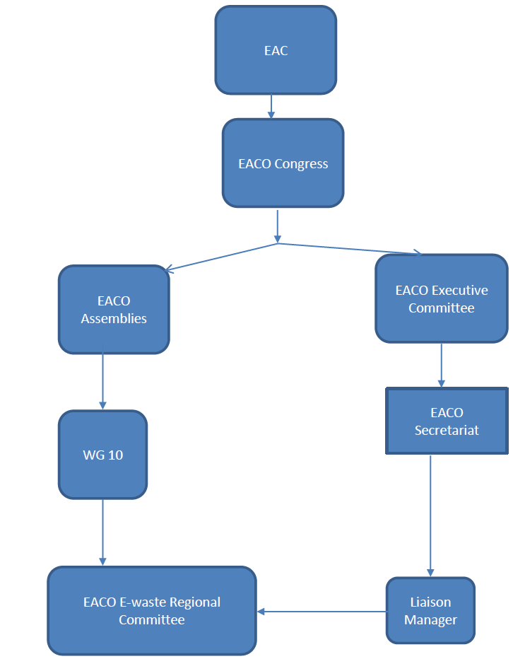
Articulate Implementation Framework
Existing Organization structure

Slide 21
Articulate Implementation Framework
Partnership and coordination with different stakeholders will ease delivery
RSC
WG 7
Producers, Importers
Implement Extended Producer Resposnibility program
Finance collection and treatment
Progress reporting on Regional Strategy
Supervision and overall coordination with NCS
Partnership EACO to create the PRO and E-waste fund
EACO
“achieve a sustainable e-waste management system in the EACO member states”.
Enforcement of laws and regulations
Regulators ( UCC,
RURA, CA, TCRA,etc)
Private sector
Type approval , data reporting ,
Financial contributions
Partnership in setting up required infrastructure, collection and treatment of e-waste
Transboundry movement of e-waste within the region
Finance the strategy
Technical
Assistance
Capacity Building and Awareness raising
Environment and Safety compliance audits
Agencies in Member states ( REMA, NEMA, NEMC, etc)
Development Partners

Slide 22
Thank You

