Slide 1

THE 3RD EACO REGIONAL WORKSHOP ON SUSTAINABLE E-WASTE MANAGEMENT IN THE EAST AFRICAN REGION (14TH -16TH MAY 2017, KIGALI RWANDA)
ITU-T SG5RG -AFR WORK ON E-WASTE MANAGEMENT
HELEN C NAKIGULI
SENIOR OFFICER ENVIRONMENT MANAGEMENT, UGANDA COMMUNICATIONS COMMISSION
CHAIR – ITU-T SG5RG AFR AND QN 7/5 ASSOCIATE REPPORTUER

Slide 2

Outline
Brief overview on ITU
Weakness of e-waste management systems
ITU work on e-waste and its management
Mandate of the ITU-T SG5 Regional group for Africa
Conclusion and next steps

Slide 3

Overview of ITU
What is ITU?
Role
ITU (International Telecommunications Union) is the United Nations specialized agency for information and communication technologies (ICTs)
To facilitate peaceful relations, international cooperation between peoples, and economic and social development by means of efficient telecommunications services

Slide 4













Overview of ITU
193 | 550 | 140 | 170
MEMBER STATES | SECTOR MEMBERS | ACADEMIA MEMBERS | ASSOCIATES
OUR MEMBERS
3 SECTORS
STANDARDIZATION
DEVELOPMENT
Each sector has separate mandate, but all work cohesively towards connecting the world
RADIOCOMMUNICATION

Slide 5
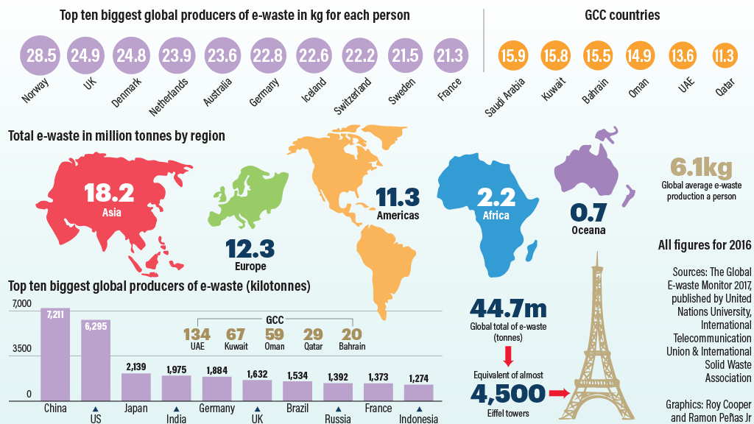
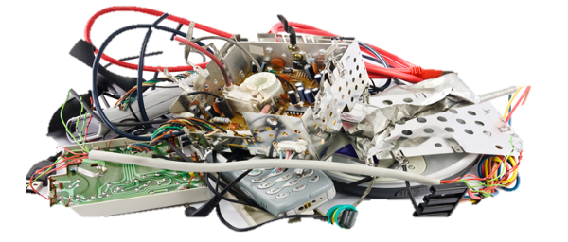
Weaknesses of e-waste management systems
Heterogeneous
reporting requirements
E-waste dispersed
Speculation on compliance costs
Illegal traffic
Lack of internationally comparable data
Lack of transparent management of funding
Developing country-specific criticalities
No clear common definition
In 2016, 44.7 million tons of e-waste were generated, of which only 20% were collected, in average, worldwide
Source: ITU/UNU/ISWA, 2017
Notes:
In this slide I would like to present some of the problems encountered by countries in managing e-waste, starting from the lack of an internationally agreed definition of e-waste, moving to the problem of e-waste dispersion and the specific criticalities faced by developing countries.
The lack of definitions hinders country’s ability to compile harmonized statistics and consequently to have a clear picture of where to streamline resources. Setting targets and measuring progress of both national e-waste management systems and projects might also be inhibited. Furthermore, this issue hinders efforts to prevent illegal traffic.
Finally, in absence of a common definition, it is not possible to have homogeneous reporting systems, which in turn prevent the comparability of national statistics. In addition to this, manufacturers operating in various countries might find it difficult and onerous to comply with different reporting obligations.
Dispersed waste refers to EoL equipment that is not being managed by the official system nor by the informal channel. It constitutes an almost physiological fraction of e-waste generated in every country, industrialized and developing, and represents an economic and environmental cost.
Part of the e-waste collected is intercepted by the informal sector. The most valuable part of WEEE generated normally eludes the official system. Informal sector often does not comply with legal requirements and best practices, nor are they registered with the relevant authorities, or have requested for a permit or underwent independent audits.
Transboundary movements of e-waste represent a significant fraction of e-waste generated in industrialized countries amounting at approximately 50-80%. Due to ambiguous definitions for e-waste and used EEE it is difficult to distinguish between these two categories, hence contrasting the illegal traffic of e-waste, especially as e-waste is shipped as used equipment. Reaching an agreement on definitions, classifications and trade codes would certainly contribute to address these issues.
Although the consumption of electric and electronic equipment in developing countries is rising, developing countries are still responsible for a negligible fraction of e-waste generation For instance, by the year 2030, the developing world is forecast to discard 600 million of personal computers annually, twice the amount generated by industrialized countries. The fact that most electrical and electronic equipment in developing countries is imported means also that these countries often lack the expertise to recycle equipment effectively. In addition, a significant part of these EEE are of poor quality and imported even if nearing their end-of-life. This factor contributes to the increasing rate in the generation of e-waste. In parallel, some developing countries are introducing incentives to support the electrical and electronic industry by subsidizing sales of EEE. In the not that far future these equipment will become waste and the lack of a national system for their management will have severe consequences on human health and the environment.
Most developing countries have introduced provisions on e-waste, but only within more generic legislation on wastes and hazardous wastes. National waste regulations are not suitable to allocate clear responsibilities on all stakeholders involved and set up a country-wide e-waste handling and management system.
Lack of e-waste management legislation is often correlated with the absence of adequate recycling technologies. Given that law normally tries to fit the capabilities of a country, policy-makers might be reluctant to impose processing standards when the technology necessary to comply with them is not currently available in the country.
Lack of data relative to EEE and WEEE markets hinders governments’ capacity to understand e-waste-related problems and opportunities in each specific country.
Usually, developing countries have a predominant organized informal sector, especially for the collection and recycling phases of the EoL chain.

Slide 6








ITU programme on tackling e-waste &
achieving a circular economy
Using ICTs to protect the environment
Develop international standards to protect the environment
Assist countries to develop policies and implement ITU-T standards to tackle e-waste and & achieve a circular economy
Help companies becoming more sustainable and socially responsible
Research and development on areas which include e-waste, circular economy and smart sustainable cities
Raise awareness on role of ICT in tackling environmental challenges

Slide 7



ITU-T Study Group 5: Environment, Climate Change and Circular Economy
Development of standards
SG5 is responsIble for:
Lead Study Group for
electromagnetic compatibility, lightning protection and electromagnetic effects
ICTs related to the environment, climate change, energy efficiency and clean energy
circular economy, including e‑waste
Studying ICT environmental aspects of electromagnetic phenomena and climate change.
Q7/5 - Circular Economy including E-waste
(Under ITU-T standardization)
Studies on how to use ICTs to help countries and the ICT sector to adapt to the effects of environmental challenges, including climate change, in line with the SDGs.
WP1/5 - EMC, lightning protection, EMF
WP2/5 - Environment, Energy Efficiency and the Circular Economy

Slide 8
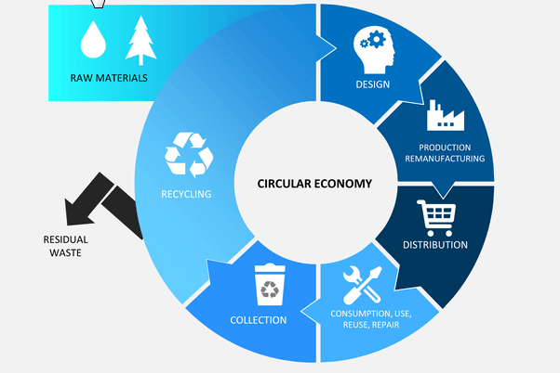
Importance of global standards
Drive competitiveness, for individual businesses and world economy
Manufactures, networks operators and consumers
Reduce negative impacts oont he environment
Reduce technical barriers
Foster interoperbility
Lower prices
Work with us!

Slide 9



ITU-T SG5RG – AFR (mandate)
ITU-T SG5RG – AFR is the regional group for Africa under ITU
The main objectives of ITU-T SG5 RG – AFR are;
To encourage participation of African countries in the work of ITU-T SG5,
Boost discussions on current issues, challenges as well as priorities in the African continent,
Enhance the development of contributions from Africa that form part of the development of international standards that meet the particular requirements of the region.

Slide 10


1st regional meeting for the study period 2017-2020
8th Green Standards Week
“Linking circular Economy and industry 4.0”
9-12 April 2018
Zanzibar, Tanzania
The Green Standards Week acts as a global platform for discussion and knowledge-sharing in order to raise awareness of the importance of and opportunities for using ICTs to protect the environment, unlock the potential of circular economy and expedite the transition to smart sustainable cities.
12th ITU Symposium on ICT, Environment and Climate Change, 9 April 2018
ITU-TSG5 RG-AFR meeting
9th April 2018
So far 9 contributions endorsed during the 1st regional meeting and to submitted to the parent group (ITU-T SG5) for consideration. 8 out of 9 on e-waste and the circular economy.

Slide 11


Conclusion and next steps
Conclusions & Next Steps
Policy makers should have long-term sustainability ambitions
  Consider e-waste management in the design of ICT policies
  Implement international standards (ITU-T Recommendations) at the national level
  Encourage concerted cooperation in handling e-waste
  at the national, regional and international level
Improve the sustainability and competitiveness of manufacturing and business practices
  Create manufactured (or imported) products through economically-sound processes that minimize negative environmental impacts while conserving energy and natural resources
  Sustainable manufacturing also enhances employee, community, and product safety and promote green jobs
Foster public-private partnerships
Raise awareness at consumer level

Slide 12
Thank you

