Slide 1
STATUS OF INTERGRATED SUSTAINABLE E-WASTE MANAGEMENT IN KENYA
“towards zero negative impact of e-waste in the EACO member states by 2030”
By Eric Guantai
Vice secretary National E-waste Steering Committee -Kenya
Founder & C.E.O
RECYKLA INTI’L

Slide 2
Policy, Legal and regulatory frameworks
The level of E-waste activities and programs being implemented by intuitions (both private and government) independently or collectively in partnership (symbiotic business relationships) with either formal or informal E-waste enterprise is low (mostly in major urban setups like Nairobi, Mombasa, Thika, Nakuru, Kisumu ) and absent in rural areas. Other entrants in this are urban community based groups in partnership with either formal or informal E-waste enterprises.
These kind of initiatives or programs are supported by organizations (both Private and Government) which are looking for avenues to dispose their WEEE ethically and in a sustainable way. Therefore in most cases it’s either once in a years or twice (for larger ICT equipment) while consumables is frequently.

Slide 3
Policy, Legal and regulatory frameworks (cont’d)
However this happening even in the absence of WEEE directives i.e. WEEE polices, WEEE regulations and WEEE legislations in Kenya which is yet to be adopted.
Thus some private organization (individually or collectively) foreign or local have initiated in-house tailor made sustainable E-waste programs to offer solutions to challenges that arise from their own end of life products i.e. Safaricom, M-kopa solar (Renewable energy sector #off-grid energy).
E-waste as a business in Kenya has been embraced by both formal and informal E-waste entrepreneurs who collect ,dismantle and further sell in the local market; metal or plastic (recovered materials, NO value addition done at this level) to plastic/metal dealers (value addition done at this level) or export E-waste fragments (both valuable and dangerous fragments) to E-waste facilities or markets in developed economies guided by international acceptable legal instruments ie Basel convention, Bamako convention etc.

Slide 4
Infrastructure for E-waste Management
Intuitions implementing E-waste programs and activities in most cases are not staff centric i.e. reaching out to staffs to increase their capacities in sustainable E-waste management at Household levels.
Public Awareness on sustainable E-waste management in Kenya is very low. It is only relatively high where they exist well-structured E-waste activities (programs) mostly at institutions level (both private and government) i.e. Safaricom, Academia- Multimedia University
Majority of Consumer of Electrical and Electronics Equipment at household levels are holding back large end of life Waste Electrical and Electronics Equipment (E-waste) either for lack of information on where to dispose (collection points) or lack of incentives in spite of dangers they are exposed to by Waste Electrical and Electronics Equipment (E-waste).

Slide 5
Infrastructure for E-waste Management
(cont’d)
WEEE (E-waste) has always been collected together with municipal residual waste (lack of E-waste separation at source) thereof disposed both in illegal dumpsite and legally designated landfills. Therefore losing positive economic value that would have been realized through support of establishment of formal recycling infrastructure both by National and County Government.
However it’s ironical that they (households) are more than willing to pay for garbage collections service providers who collect garbage from their residential areas or private offices but withhold paying for E-waste collections.
E-waste as a business segment (Circularity) in Kenya has not been given the same holistic integrated attention (i.e. creation of friendlier E-waste business ecosystem like ; policies, access to finances/credit, Tax emptions/rebates or waivers, etc.) like other business segments yet it contributes in; sustainable incomes ,sustainable employment, sustainable environment & sustainable societies.

Slide 6
Infrastructure for E-waste Management
(cont’d)
Faulty Electrical and Electronics Equipment (both small and large) that need some minor repairs have led to establishment of Electrical and Electronics repair shops and refurbishing business enterprises. These E-waste enterprise have perfected sustainable urban mining business models.
These E-waste entrepreneurs at various point in the conveyer belt of E-waste management (at repair and refurbishing centers) are faced with various capacities gaps and challenges in the disposal of Waste Electrical and Electronics Equipment (E-waste) at their possession sustainably which is inclusive of those containing Ozone Depleting Substances (ODS) ) –losing on carbon credit .
The entry of Smart technology i.e. Internet of Things (IoT) or Artificial Intelligence will quadruple the E-waste generations and pollutions whilst increasing the demand for raw materials i.e. rare earth minerals mostly sourced from Africa (DRC) hence continued to fuel armed conflicts and displacement of communities by extractive industries etc.

Slide 7
Infrastructure for E-waste Management
(cont’d)
This threaten our survival not only in Kenya and our respective countries but as a Africa region since ecosystem (ecology) and livelihoods are impacted negatively by end of life of Waste Electrical and Electronics Equipment (E-waste) inclusive of consumables which are unethically disposed.
Thus E-waste entrepreneurs (both formal and informal) bear the cost of Disposal (they also pay for destruction harmful fragments in advanced E-waste facilities located in developed economies) ,Collection ,Transportation and Recycling (machinery).
Because I believe that a one-size-fits all approach seldom works perfectly. We need E-waste plan that uniquely offers sustainable solutions not only to East Africa region E-waste challenges but Africa as a whole.

Slide 8
Infrastructure for E-waste Management
(cont’d)
Industrial parks concepts in Kenya has been supported not only by private sector but also the Government. However there is need to establish using the same Industrial parks structures Green Zones or Green Industrial parks. This will allow scaling up of Low carbon and Climate Change resilient Industries i.e. E-waste facilities, collection points (holding ground), E-waste sustainable Value additions industries etc. further becoming Center of Excellence.
Noting of absence of tailor made WEEE directives in Kenya i.e. WEEE polices, WEEE regulations and WEEE legislations and inadequate Government support while cognizant of existence of international instruments i.e. Basel convention, Bamako convention, Minamata convention etc. there is a rise in E-waste enterprises both formal and informal in Kenya.

Slide 9
Infrastructure for E-waste Management
(cont’d)
E-waste entrepreneurs (both formal and informal) capacities need to be increased to allow them become more competitive economically whilst manage environment sustainably. Enhanced capacities will allow them mainstream ethical business operations standards and procedures thereof embrace environmental governance. Further it promote creativity in innovation and inventions leading to sustainable value additions at various levels of E-waste recycling process.
There is need to have WEEE Standards to be complied with, tailored to guide sustainable E-waste management (recycling and processing) for E-waste entrepreneurs (both formal and informal) as well by Producers . This will allow promotion of E-waste best practice, competence, ethics, integrity at workplace, develop a pool of specialized WEEE Auditors and enhance professionalism. Thereof curbing any unethical or fraudulent practice in E-waste business segments or E-waste diversion thus restoring Producer confidence.

Slide 10
Resource mobilization
Even in the presence or absence of WEEE directives i.e. WEEE polices, WEEE regulations and WEEE legislations while also cognizant that East Africa member countries are at different levels in the implementations of WEEE Directives (WEEE polices, WEEE regulations and WEEE legislations), there is also need as East Africa Community regional block to explore opportunities ( new or existing) that offer opportunities to create synergies and leverage our efforts curbing duplication of results /cost tailored towards addressing integrated sustainable E-waste through provision of customized solutions to Africa E-waste challenges affecting not only members countries of East Africa Community (EAC) but Africa as a whole.
Not only do we need to develop and enhance symbiotic business relationship with Academia, Donor Communities, Regional Organizations but also Producers centered organization (Extended Producer Responsibility/Public Responsible Organization) with a focus on implementing sustainable E-waste solutions not only for East Africa region E-waste challenges but Africa as a whole like WEEE Africa Forum …… etc. thereof mainstream strategies “towards zero negative impact of e-waste in the EACO member states by 2030.”

Slide 11
Resource mobilization (cont’d)
Such initiatives become an enabler of being identified as Voice of Reasons for provision of practical sustainable E-waste solutions not only in East Africa region E-waste challenge but Africa as a whole. Thus contribute in the development of harmonized friendlier integrated WEEE Directives i.e. WEEE polices, WEEE regulations and WEEE legislations for Africa region.
Further it allow us engagements with other peer organization e.g.
1) ITU-D-Telecommunication Development Sector (ITU-D);
2) Southern Africa Telecommunications Association (SATA);
3) West Africa Telecommunications Regulators Assembly (WATRA);
4) Arab Information and Communication Technology Organization (AICTO);

Slide 12
Resource mobilization (cont’d)
5) African Telecommunications Union (ATU) a specialised agency African Union, in the field of telecommunications;
6) Economic Community of West African States (ECOWAS);
7) Southern African Development Community (SADC);
8) East African Community (EAC);
9) Africa Union;
10) Association of Regulators of Information and Communications for Eastern and Southern Africa (ARICEA) –COMESA region;
In this way it possible to have Integrated Sustainable E-waste Management included as one of the African Union Agenda 2063 working closely with relevant working groups thereof mainstreamed across all Africa Union countries members whose chair is the president of Rwanda His Excellency Paul Kagame.

Slide 13
Institutional , coordination and alignment
Within the E-waste business ecosystem we have various service and solution providers both formal and informal sectors (at various levels of formalization process and are the majority in Kenya and Africa as a whole) exposed to myriad of challenges inclusive of access to raw materials (E-waste) exploitation and manipulations by various stakeholders inclusive of Producers and other E-waste handlers.
We need to mainstream E-waste Agendas in Country Vision or Agendas developed. Thus though members countries of East Africa Community (EAC) are at different levels of economic transitions inclusive of polices, legislations and regulations majority have Country specific Vision or Agendas ie Kenya we have Vision 2030 and BIG 4 AGENDA (B4G), Rwanda Vision ……,Tanzania Vision……….,Uganda Vision …….., Burundi Vision ………etc

Slide 14
Institutional ,coordination and alignment (cont’d)
Therefore there is need to also include and mainstream integrated sustainable E-waste management tailor made approaches in these Visions and Agenda through the lenses of Circularity (Circular Economy) or Region specific Vision (SADC EAC, COMESA ECOWAS) further to mitigate illegal flow (or support and facilitate legal flow) through our porous boundaries.
Regulators (communication Authorities) are key government intuitions that not only regulate ICT business ecosystem (segments) but also offer oversight roles and advice to the rest of government ministries agencies etc. in the procurements of ICT Electrical and Electronics Equipment and products (consumables) or establishment of ICT infrastructures in the country or counties -(National and County governments in case of Kenya).

Slide 15
Institutional , coordination and alignment (cont’d)
Thus to scale the level of integrated sustainable E-waste management within government intuitions and agencies, Regulators (communication Authorities) need to mainstream integrated sustainable E-waste methodologies or strategies (from planning to tendering to performance and contract closure) while advising various government agencies /ministries in the procurements of ICT Electrical and Electronics Equipment or in the establishment of ICT infrastructures in the country or counties (for Kenya). Hence facilitate friendlier management of Waste Electrical and Electronics Equipment (E-waste) thereof i.e. reverse logistic ,takeback by producer/vendors etc. This enables Greening the procurement process at all levels in the Government programs and activities.

Slide 16
Institutional , coordination and alignment (cont’d)
Involvement of regulators is also key in the implementations of Integrated Sustainable E-waste Management in Kenya. Regulators effect any directives such Executive orders, Ministerial orders and Act of parliament other than policies, regulations, legislation.
To address WEEE disposal, WEEE collection, WEEE transportation and WEEE recycling in Kenya. There is need to pursue pathways such as issuance of Executive orders, Ministerial orders and Act of parliament tailored towards WEEE (E-waste) management in a sustainable way,(where there is delay caused by bureaucracy to effect WEEE Directives i.e. Kenya) e.g. make it mandatory for private and government organization to dispose E-waste only to E-waste enterprises whilst E-waste enterprise comply with term and conditions established by various institutions.
Observing that in most instances regulators might be more than one, there is need for coordinated collaborations from a central command center with well-defined roles to avoid duplication and facilitate ease of doing E-waste business ie develop single harmonized E-waste operations licenses.

Slide 17
Institutional , coordination and alignment (cont’d)
Such mainstreamed integrated sustainable E-waste methodologies or strategies, must make it harder to do wrong thing (unethical) through punitive measures need also to be inclusive in Executive orders, Ministerial orders and Act of parliament) should include but not limited to i.e. partnership with local legally E-waste entrepreneurs or E-waste facilities by producers /vendors, withdraw of operating licenses for Producers and mandatory for producers to comply with compliance schemes.
Thus Regulators (communication Authorities) in the East Africa Region collectively need to bench mark with each other to allow; coordinated integrated ,sustainable E-waste methodologies or strategies with their respective governments, to help mitigate E-waste pollutions emitted by government inclusive of legal/ethical movement (inclusive of cross boulder trade) of documented Waste Electrical and Electronics Equipment creating uniform check and balances which facilitate integrated sustainable E-waste management. Also adhered to by producers or vendors whose Government are their biggest clients across Africa countries. This bench marking apply also with WEEE organizations in Africa, Europe, etc

Slide 18
Capacity building, Research, Monitoring and Evaluation
The evolutions in technology at rapid speed has flooded the Kenyan market with both genuine and counterfeits Electrical and Electronics Equipment. Tactical strategies adopted by Producers (Original Equipment Manufacturer) either manufacture products with short life span or fail to avail spare parts (plan obsolesces) contribute to the increase in E-waste being generated. Further this is compounded by counterfeits that are ripping off clients their hard earn incomes.
The demand for Electrical and Electronics Equipment has attracted entrants of Producers (both new and existing) in Kenya to adopt online marketing platforms ie OLX, JAMII, SAFARICOM etc
Further there is inadequate and sustained information from majority of Producers operating in the Kenya ,in their market/sales strategies which inform their clients how to sustainably dispose waste arising from their end of life products (Electronic and Electrical Equipment).

Slide 19
Capacity building, Research, Monitoring and Evaluation (cont’d)
Indigenous knowledge (technology) mostly consumed by informal sectors in Kenya is the most preferred over those used in developed economies (and by formal sector) which is more effective and efficient because of Cost.
However certain Indigenous knowledge (technology) in its current status are disadvantaged in comparison to that used in developed economies (and by formal sector) because they are not efficient and effective further contributing to lose of economic value and contribute to environmental pollutions.
Further Academia and innovations hubs should also be involved i.e.. E-waste business boot camps/hackathon, E-waste research programs looking at E-waste generated (Data), impact on ecology (air, water and soil) ,marine life (blue economy) etc.
Academia should ensure written research papers or filed patents, inform development of tailored solutions or products to solve E-waste identified challenges or E-waste capacity gaps thereof deployed in the market (reach the people they are made for).

Slide 20
Capacity building, Research, Monitoring and Evaluation (cont’d)
The “big fat wall” that stands between academia and industry.
The academia is happy to do research in labs and create prototypes; while industry will invest in manufacturing and distribution only if the product is saleable.
But taking the device from prototype to [saleable] product stage where there is a deep ‘valley of death’ between academia and industry .It is this critical gap—where pilot manufacturing, technologies trials and regulatory clearances are undertaken.
Throughout this difficult, often lengthy, journey from idea to reality, Academia or Jointly with Industry players need to provides complete infrastructure assistance at fully-equipped labs.

Slide 21
Capacity building, Research, Monitoring and Evaluation (cont’d)
Academia need to develop centers ( “center of excellence”) that are multidisciplinary and implement process-driven approach.
In a four-step approach (intensive four-stage admission process ), the teams must first ‘Define’ the problem they want to solve based on their interactions with WEEE integrated challenges , then Design and ‘Develop’ a prototype (if its addressing technology). Once a functional prototype is ready, the team ‘Deliver’ by undertaking trials and securing regulatory approvals, after which they ‘Deploy’ the device in the market either by licensing it to local companies or setting up their own startups. Academia should bring together medics, scientists, engineers, innovators and entrepreneurs to address WEEE integrated challenges (circular economy) . That’s how innovation happens.

Slide 22
Capacity building, Research, Monitoring and Evaluation (cont’d)
Paris Climate Change Agreement and Sustainable Development Goals (SDGs) Goals 1,2,3,4,5,6,7,8.. also offers opportunities to scale up integrated sustainable E-waste management.
Key Producers (OEMs) have also committed themselves by upholding their signatures towards the realization of goals (deliverables) as outlined by Paris Climate Change Agreement and Sustainable Development Goals (SDGs). Goals 1,2,3,4,5,6,7,8..
There is need for Producers (either individually or collectively) foreign or local to initiate effective and efficient localized tailor made compliance schemes suited to offer solutions to challenges that arise from their own end of life products. Alternatively outsource such services from local E-waste entrepreneurs legally recognized or Compliance Schemes Organisation whilst supporting them to increase their capacities. They can also help in setting up Compliance schemes organisation or E-waste facilities. Producers are able to concentrate with their Core business operation.

Slide 23
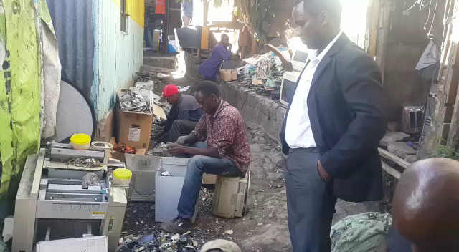
Capacity building, Research, Monitoring and Evaluation opportunities Areas

Slide 24
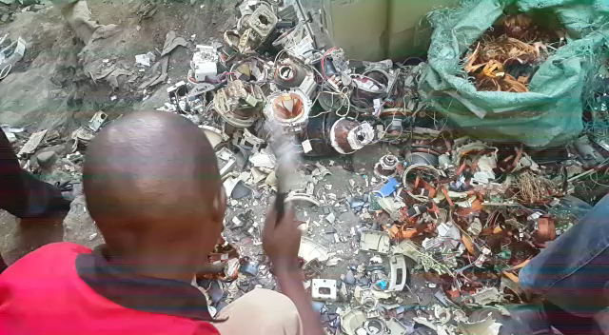
Capacity building, Research, Monitoring and Evaluation opportunities AREAS (cont’d)

Slide 25
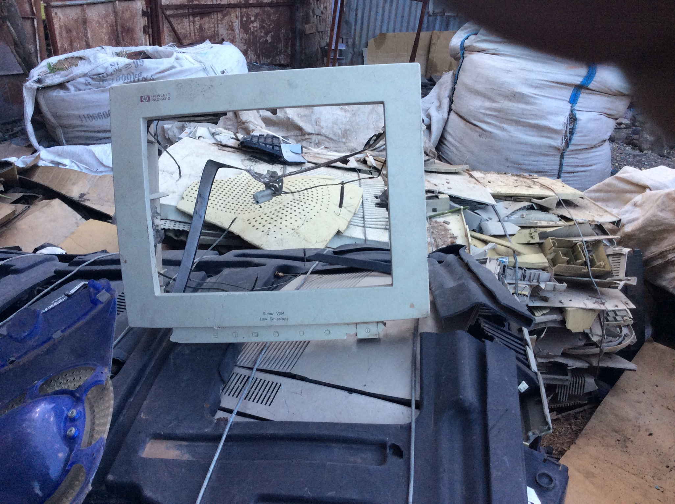
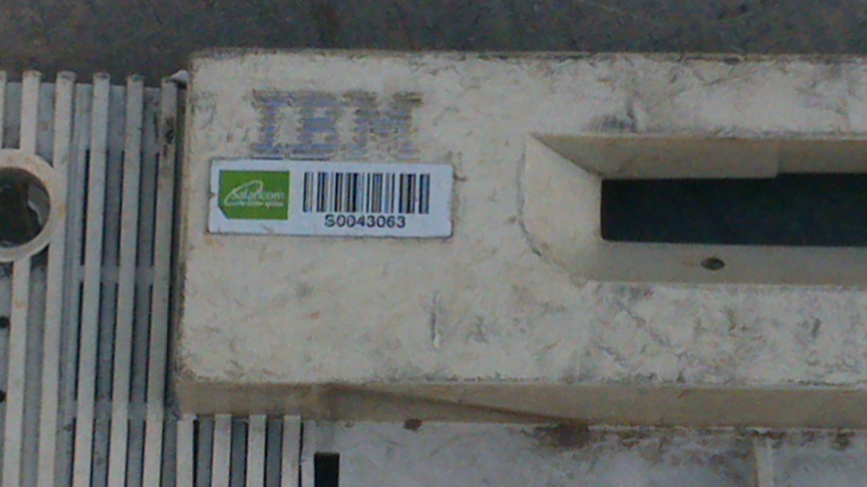
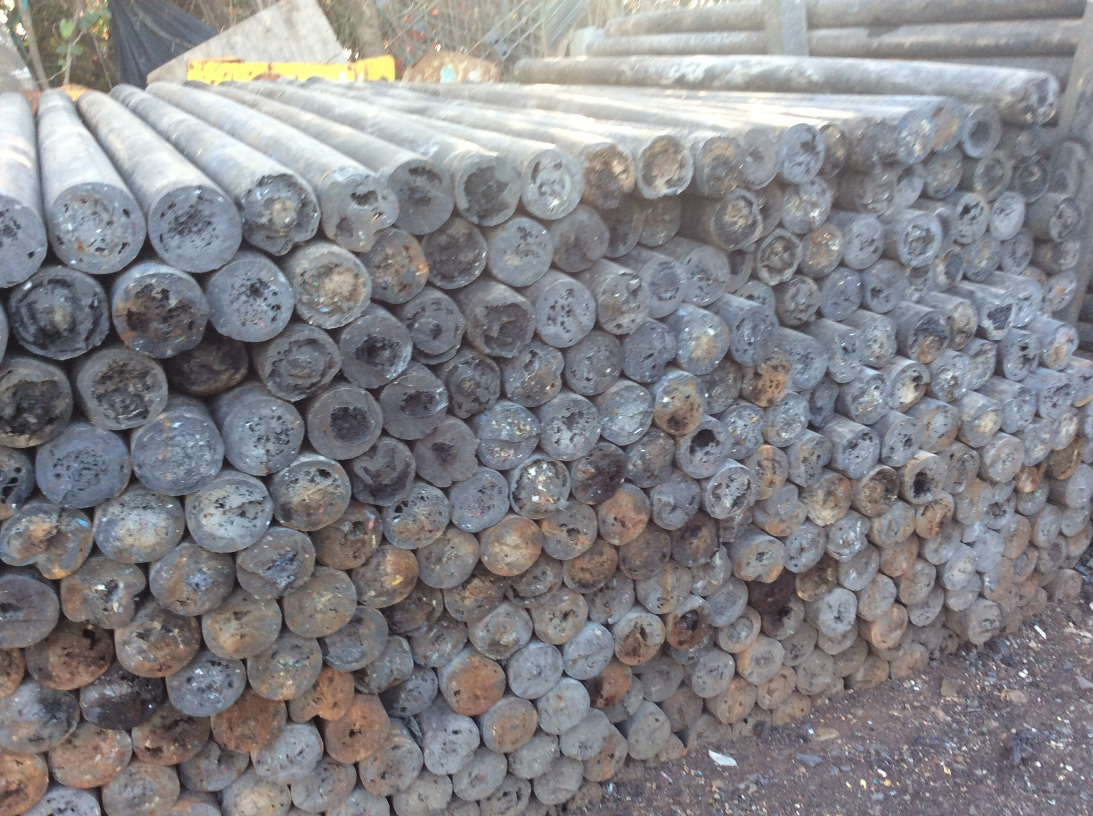
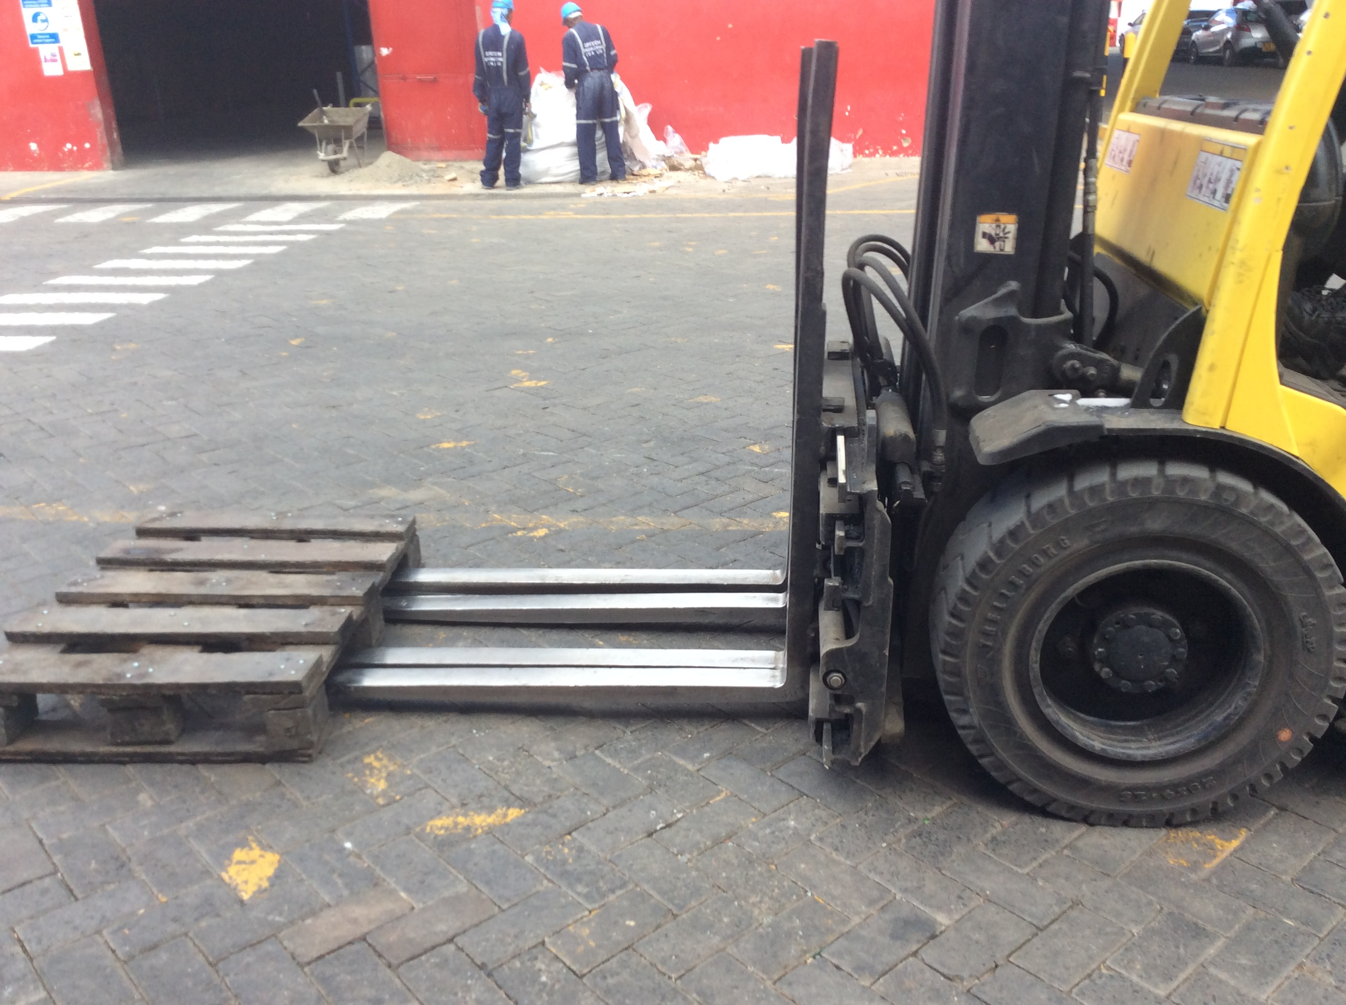
Capacity building, Research, Monitoring and Evaluation opportunities AREAS (cont’d)

Slide 26
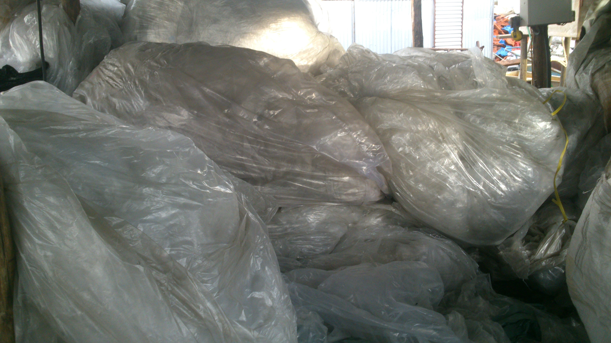
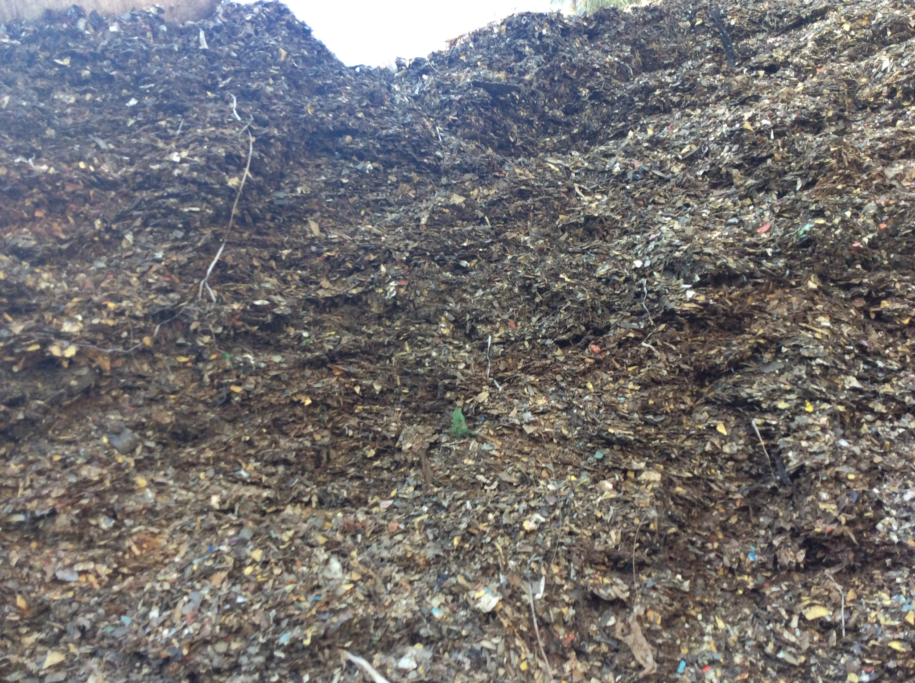
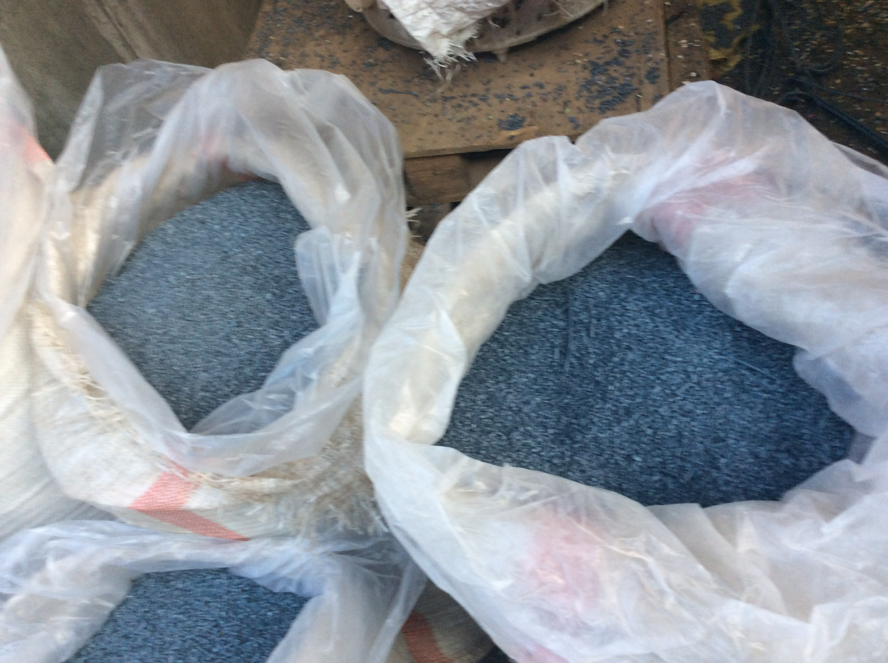
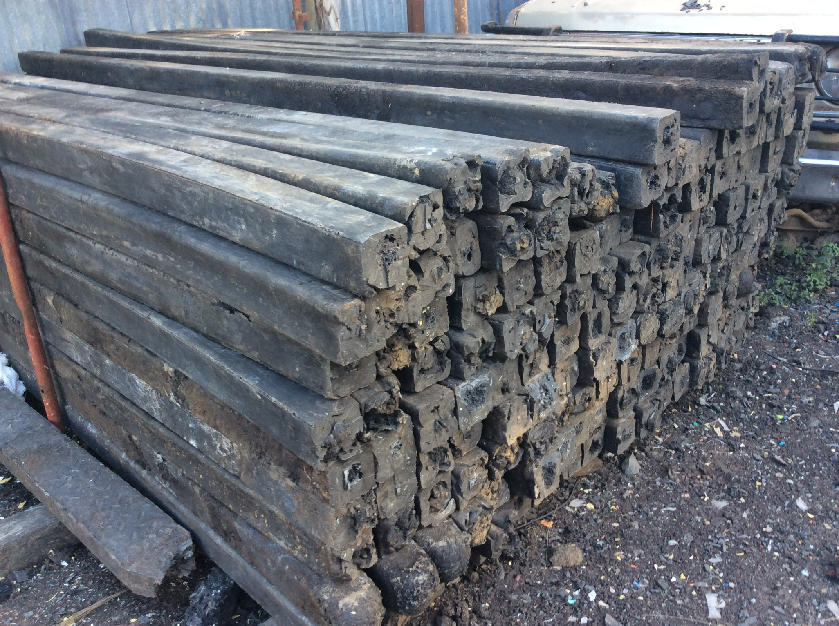
Capacity building, Research, Monitoring and Evaluation opportunities AREAS (cont’d)

Slide 27
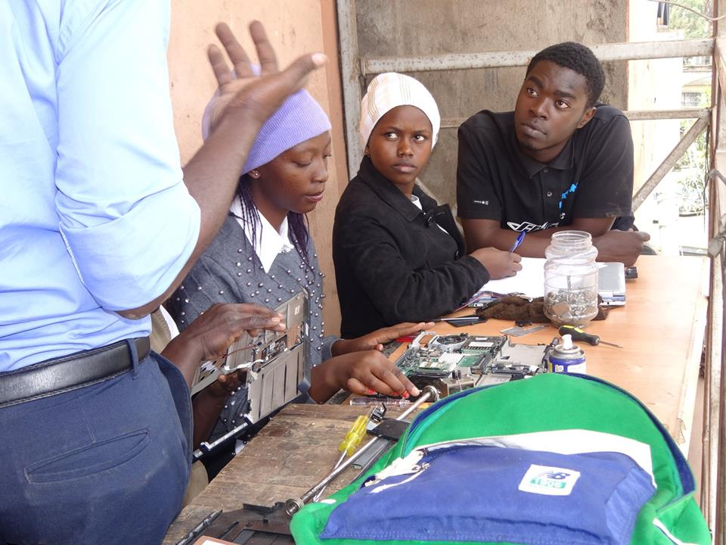
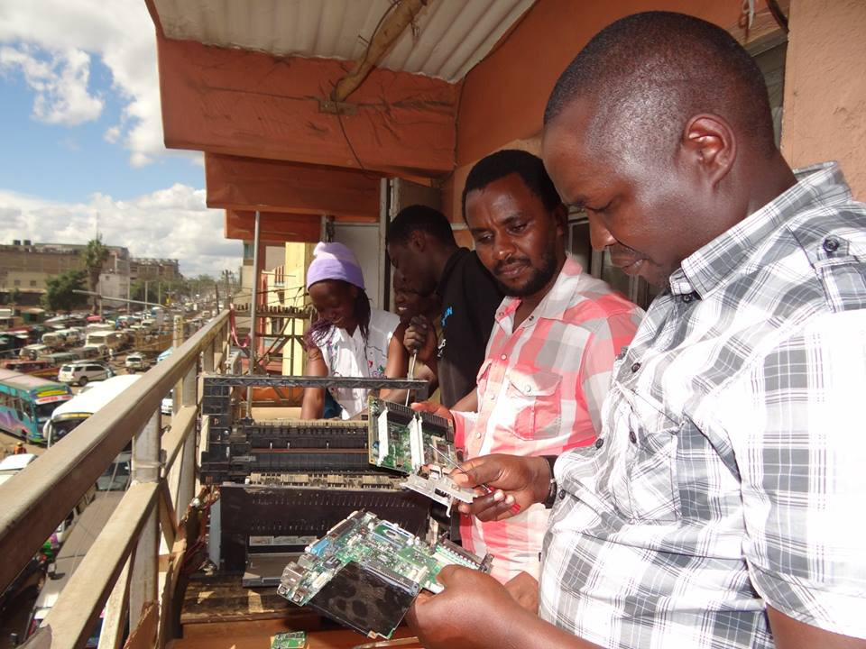
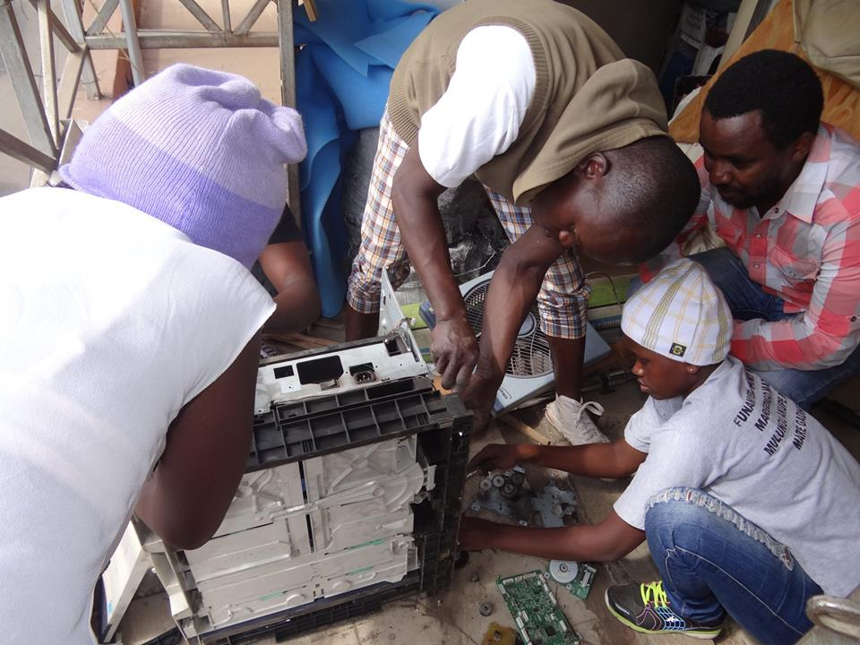
Capacity building, Research, Monitoring and Evaluation opportunities AREAS (cont’d)

Slide 28

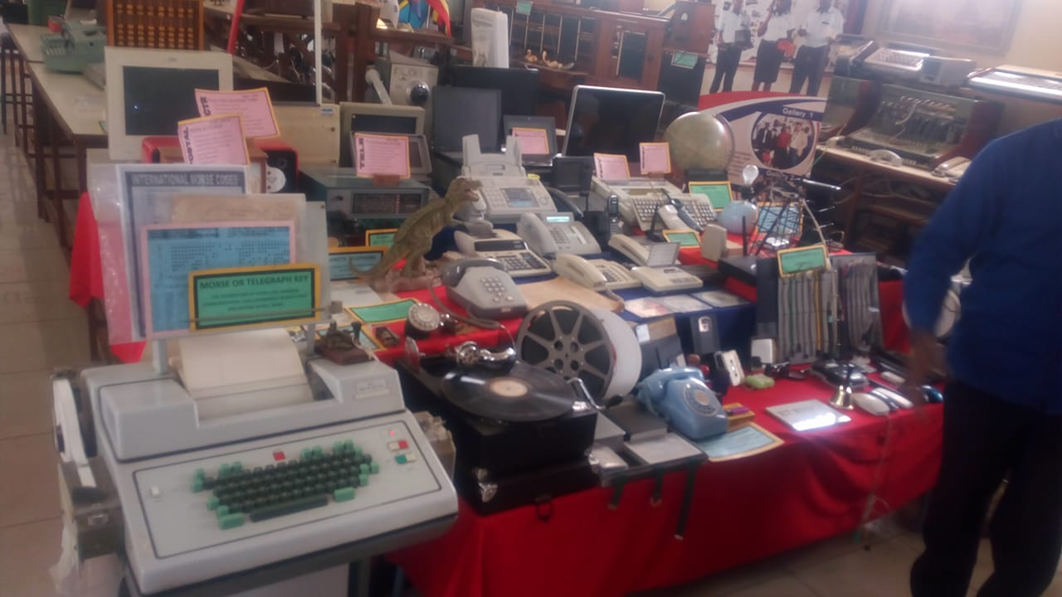
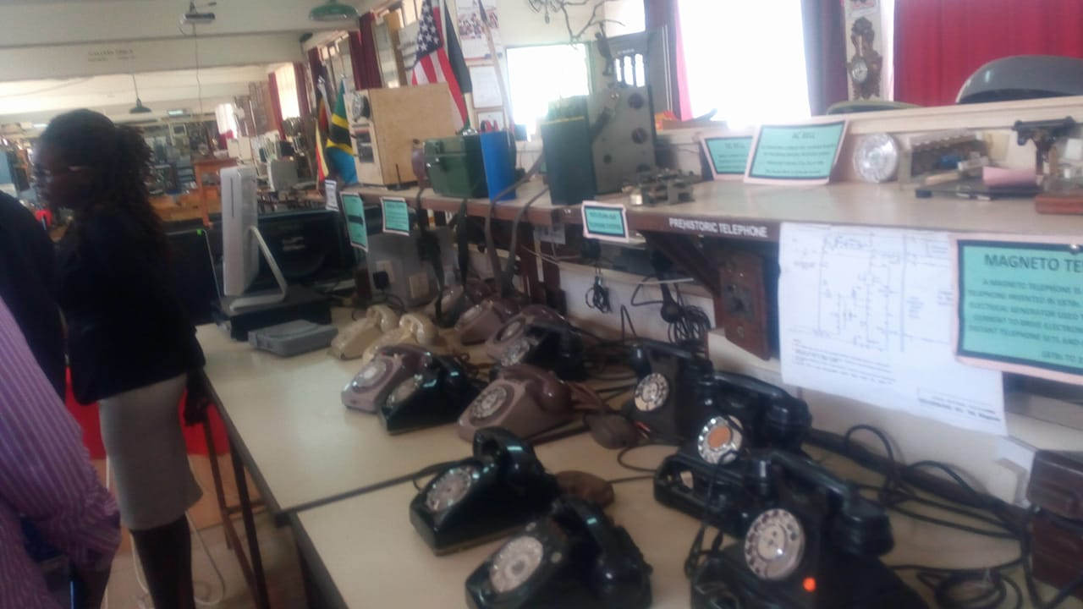
Capacity building, Research, Monitoring and Evaluation opportunities AREAS (cont’d)

Slide 29
ERIC GUANTAI
Founder & C.E.O
RECYKLA INTERNATIONAL
EMAIL; e.guantai@recyklainternational.com
WEBSITE ; www.recyklainternational.com
FACEBOOK PAGE ; www.facebook.com/Recyklainternational
TWITTER ACC.; https://twitter.com/recycklaintl

Slide 30


